Slide 1
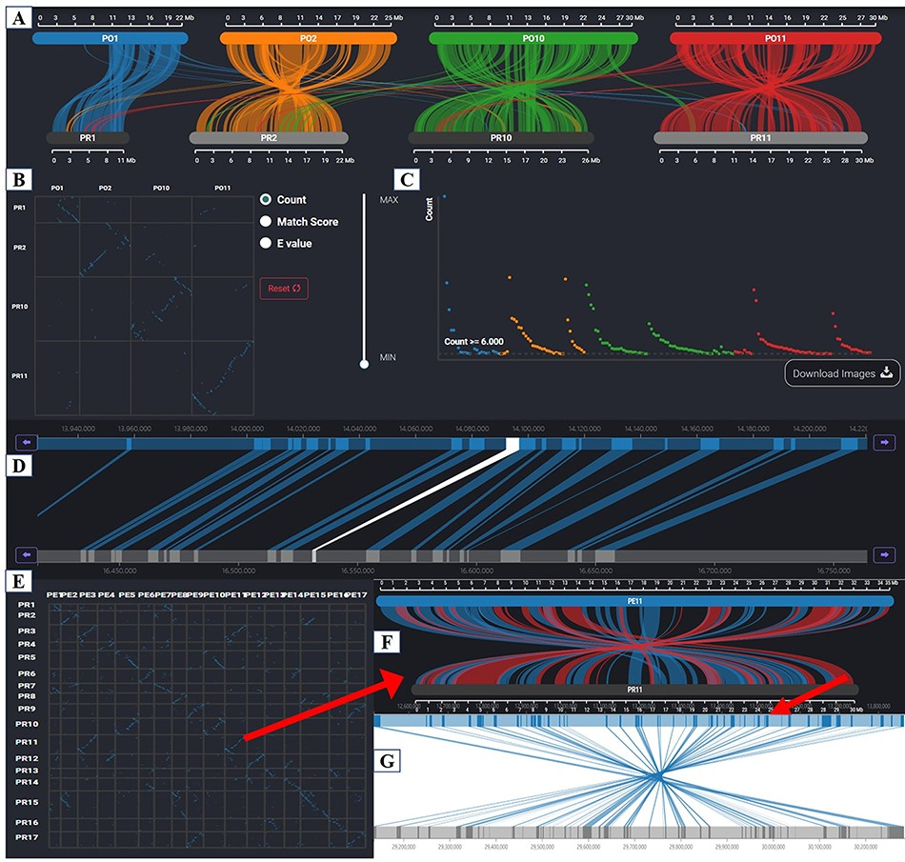
Figure 7. Synteny Browser page. (A) Macrosynteny visualization between the two pear variety genomes. (B) Dot plot ...
Notes:
Figure 7. Synteny Browser page. (A) Macrosynteny visualization between the two pear variety genomes. (B) Dot plot corresponding to the macrosynteny visualization. (C) Distribution of the number of syntenic blocks with different lengths. (D) Microsynteny visualization of the target gene. (E) Dot plot of collinearity relationships of 17 chromosomes between ‘Dangshansuli’ and ‘Duli’. (F) Macrosynteny visualization of Chr11 between ‘Dangshansuli’ and ‘Duli’. (G) Microsynteny visualization of the selected syntenic block.
Unless provided in the caption above, the following copyright applies to the content of this slide: © The Author(s) 2023. Published by Oxford University Press.This is an Open Access article distributed under the terms of the Creative Commons Attribution License (https://creativecommons.org/licenses/by/4.0/), which permits unrestricted reuse, distribution, and reproduction in any medium, provided the original work is properly cited.

