Slide 1
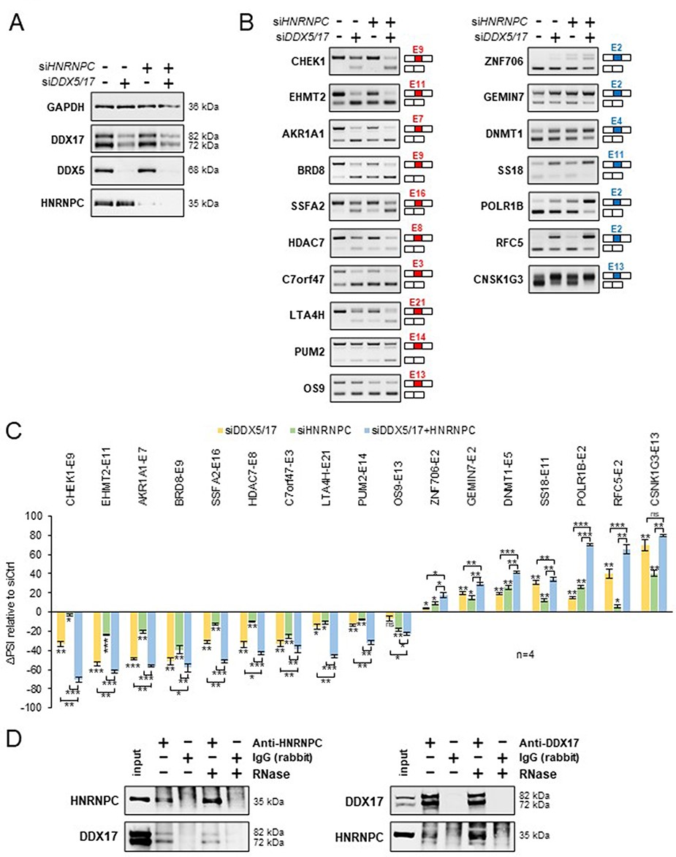
Figure 4. Validation of a functional relationship between DDX5/DDX17 and HNRNPC. (A) Western blot showing the ...
Notes:
Figure 4. Validation of a functional relationship between DDX5/DDX17 and HNRNPC. (A) Western blot showing the expression of DDX5, DDX17 and HNRNPC following the treatment with siRNA targeted against luciferase (negative control), DDX5/DDX17 and HNRNPC. Quantification of this experiment is shown in Supplementary Figure S7A. (B) RT-PCR analysis showing the inclusion of a selection of alternative exons after the depletion of DDX5/DDX17 and/or HNRNPC in 293T cells. The corresponding gene and exon number (according to FasterDB annotation) are indicated. Exons down-regulated and up-regulated upon SF knockdown are shown in the left and right column, respectively. (C) Quantification of the RT-PCR experiment. The indicated ΔPSI values correspond to the difference between the PSI value of each depleted sample and the control sample. The statistical comparison between each condition (including the unshown control condition) was calculated using a one-way analysis of variance (ANOVA) (Holm–Sidak’s multiple comparison tests: *P < 0.05, **P < 0.01, ***P < 0.001). (D) Co-immunoprecipitation assays between endogenous HNRNPC and DDX17 in 293T cells, in the absence of presence of RNase A. Alt text for Figure 4: Experiments validating the cooperative effect of DDX5/DDX17 helicases and HNRNPC on alternative exon inclusion and the interaction between DDX17 and HNRNPC in HEK293 cells.
Unless provided in the caption above, the following copyright applies to the content of this slide: © The Author(s) 2023. Published by Oxford University Press.This is an Open Access article distributed under the terms of the Creative Commons Attribution License (https://creativecommons.org/licenses/by/4.0/), which permits unrestricted reuse, distribution, and reproduction in any medium, provided the original work is properly cited.

