Slide 1
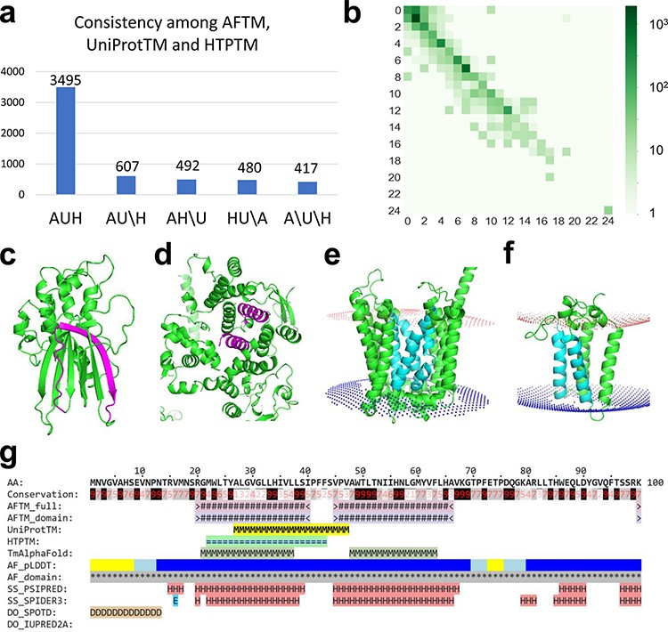
Figure 1. (a) Statistics of comparisons of TMSs annotated by AFTM (A), UniProt (U) and HTP (H). AUH: TMSs are ...
Notes:
Figure 1. (a) Statistics of comparisons of TMSs annotated by AFTM (A), UniProt (U) and HTP (H). AUH: TMSs are consistent among the three methods. AU\H: TMSs are consistent between AFTM and UniProt, but inconsistent compared to HTP. The same annotation is applied for AH\U and HU\A. A\U\H: TMSs are inconsistent among all three methods. (b) Comparison between the number of TMSs reported by AFTM and UniProt. Each square represents the number of proteins with a certain number of TMSs predicted by AFTM (X-axis) and a certain number of TMSs reported by UniProt (Y-axis). The numbers are colored according to a 10-based logarithm of the counts of proteins. (c, d) AlphaFold models of TMEM183A (accession number: Q8IXX5) (c) and UBR3 (accession number: Q6ZT12 (d), with potential false TMSs by UniProt and HTP colored in magenta. (e, f) AlphaFold models of ANKH (accession number: Q9HCJ1) (e) and ORMDL1 (accession number: Q9P0S3) (f), with missing TMSs by UniProt and HTP colored in cyan. (g) A sequence block of ORMDL1 from the AFTM website.
Unless provided in the caption above, the following copyright applies to the content of this slide: © The Author(s) 2023. Published by Oxford University Press.This is an Open Access article distributed under the terms of the Creative Commons Attribution License (https://creativecommons.org/licenses/by/4.0/), which permits unrestricted reuse, distribution, and reproduction in any medium, provided the original work is properly cited.

