Slide 1
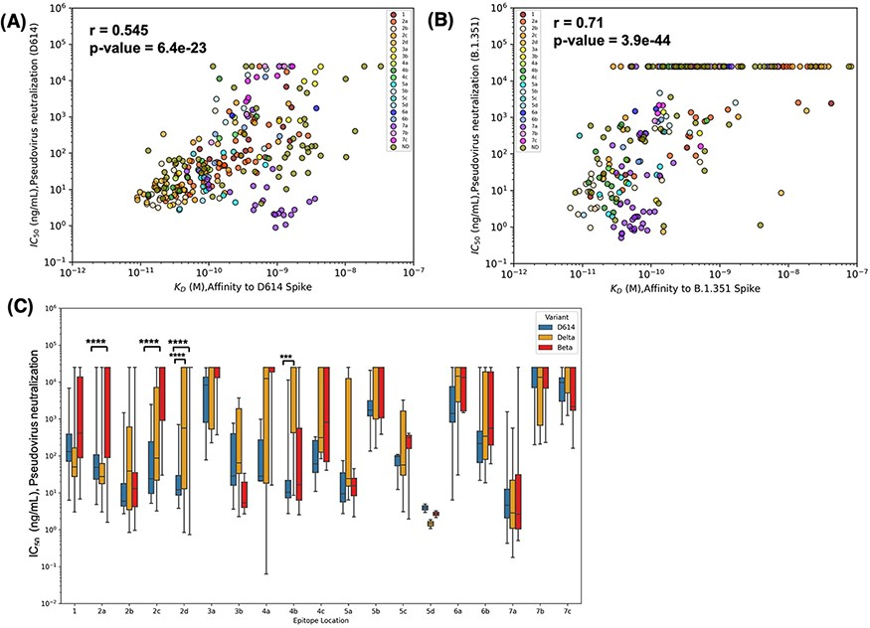
Figure 4. Epitope location and binding affinity together drive neutralization. (A) Spearman’s correlation between ...
Notes:
Figure 4. Epitope location and binding affinity together drive neutralization. (A) Spearman’s correlation between binding affinity and neutralization of pseudovirus bearing D614 spike. Data points are colored according to the epitope community to which the antibody belongs. ND: Epitope community not determined. (B) Correlation between binding affinity and neutralization of pseudovirus bearing Beta spike. (C) Epitope-wise comparison of pseudovirus neutralization of wild-type SARS-CoV-2 (D614, blue bars) and its variants Beta (red bars) and Delta (orange bars). Statistical significances were calculated using Welch’s t-test (****P < 0.0001,*** P < 0.001, **P < 0.01, *P < 0.05). Antibodies are grouped according to the epitope community, and the bars represent the mean binding affinity (note that Community 5d includes only two antibodies).
Unless provided in the caption above, the following copyright applies to the content of this slide: © The Author(s) 2023. Published by Oxford University Press.This is an Open Access article distributed under the terms of the Creative Commons Attribution License (https://creativecommons.org/licenses/by/4.0/), which permits unrestricted reuse, distribution, and reproduction in any medium, provided the original work is properly cited.

