Slide 1
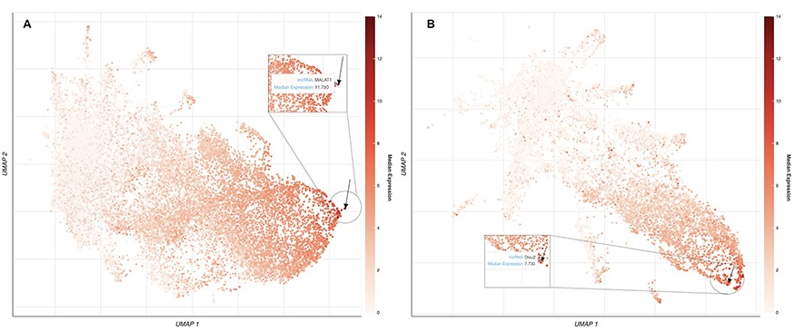
Figure 2. UMAP plots of 18 705 human lncRNAs and 11 274 mouse lncRNAs. (A) The lncRNAs level of intensity is by their ...
Notes:
Figure 2. UMAP plots of 18 705 human lncRNAs and 11 274 mouse lncRNAs. (A) The lncRNAs level of intensity is by their median expression in the testis, where MALAT1 has the highest relative expression across tissues. The arrow is pointing to the location of MALAT1 on the UMAP plot. (B) lncRNAs level of intensity is by their log median expression in the peripheral nervous system, where Dleu2 has the highest relative expression across tissues. The arrow is pointing to the location of Dleu2 on the UMAP plot.
Unless provided in the caption above, the following copyright applies to the content of this slide: © The Author(s) 2023. Published by Oxford University Press.This is an Open Access article distributed under the terms of the Creative Commons Attribution License (https://creativecommons.org/licenses/by/4.0/), which permits unrestricted reuse, distribution, and reproduction in any medium, provided the original work is properly cited.

