Slide 1
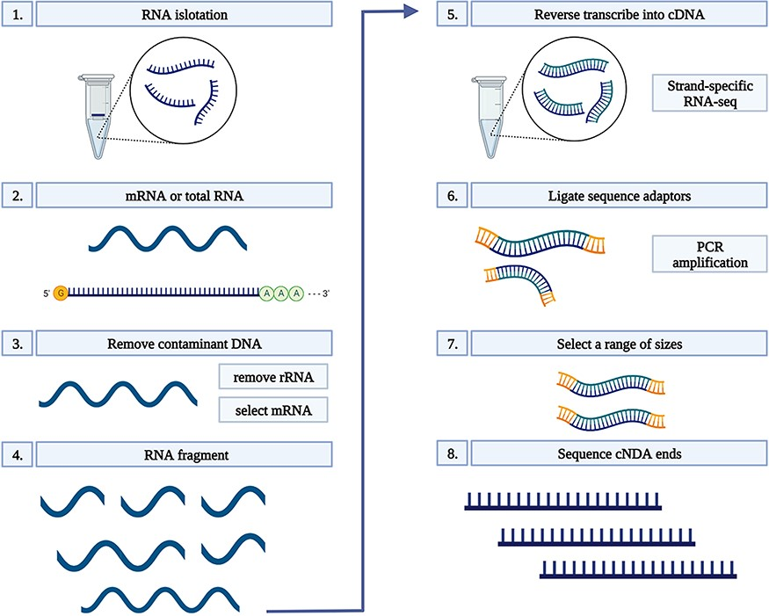
Figure 1. RNA-seq workflow. 1) Isolate the mRNA or total RNA from root tissue; 2) Quality and quantity control of mRNA ...
Notes:
Figure 1. RNA-seq workflow. 1) Isolate the mRNA or total RNA from root tissue; 2) Quality and quantity control of mRNA or total RNA; 3) Eliminate DNA contamination from RNA samples using DNase; 4) Choose an appropriate kit for library preparation based on the type of RNA. For mRNA with poly-A tail, a mRNA purification kit was used to isolate mRNA with a poly-A tail; 5) Random fragment purified RNA for short read sequencing; 6) Reverse transcribe fragmented RNA into cDNA; 7) Ligate adapters onto both ends of the cDNA fragments. 8) PCR amplification of cDNA and selection of fragment sizes between 200-400 bp. Conduct paired-end sequencing of the cDNA libraries (Martin and Wang 2011).
Unless provided in the caption above, the following copyright applies to the content of this slide: © The Author(s) 2022. Published by Oxford University Press.This is an Open Access article distributed under the terms of the Creative Commons Attribution License (https://creativecommons.org/licenses/by/4.0/), which permits unrestricted reuse, distribution, and reproduction in any medium, provided the original work is properly cited.

