Slide 1
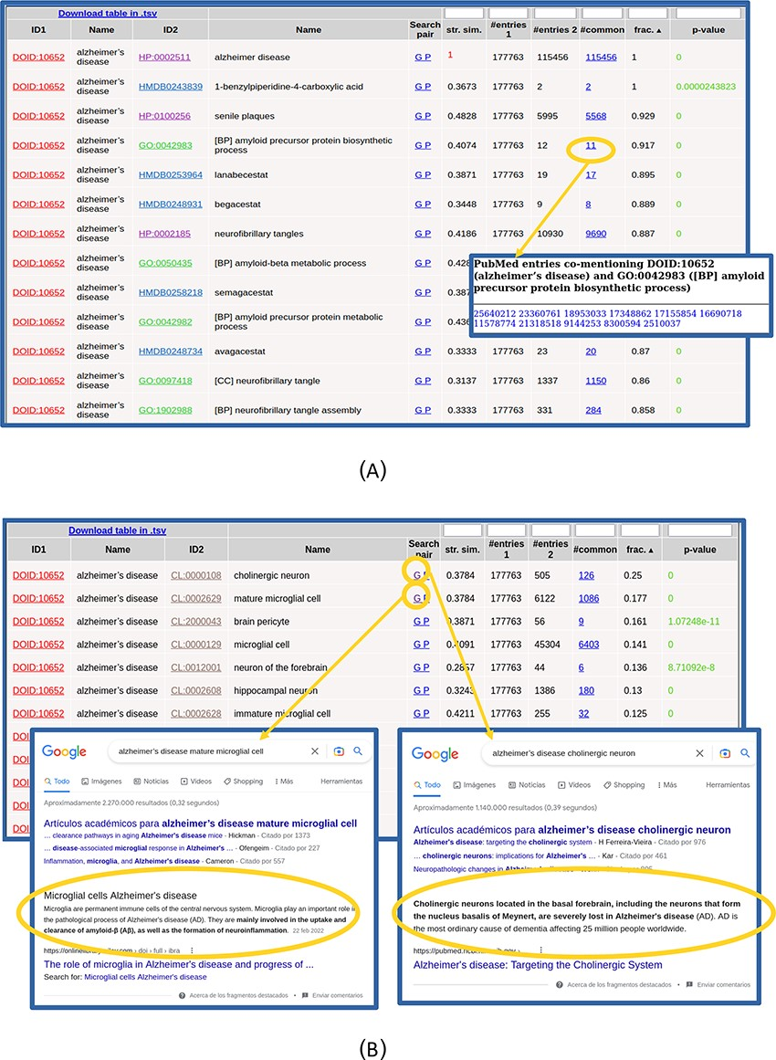
Figure 2. Table with the relationships found for ‘Alzheimer’s disease’. (A) Top of the table. The list of 11 PubMed ...
Notes:
Figure 2. Table with the relationships found for ‘Alzheimer’s disease’. (A) Top of the table. The list of 11 PubMed entries co-mentioning Alzheimer’s disease and the biological process ‘amyloid precursor protein biosynthesis’ (GO: 0042983) is shown. (B) Table with the relationships with cell types (CL) only. Screenshots of Google result pages generated with the links for the top two relationships (‘Alzheimer’s disease’ with ‘cholinergic neurons’ and ‘mature microglial cells’) are shown.
Unless provided in the caption above, the following copyright applies to the content of this slide: © The Author(s) 2024. Published by Oxford University Press.This is an Open Access article distributed under the terms of the Creative Commons Attribution License (https://creativecommons.org/licenses/by/4.0/), which permits unrestricted reuse, distribution, and reproduction in any medium, provided the original work is properly cited.

