Slide 1
Figure 1. Three main steps of a metagenomic pipeline: filtering, aligning and annotating. Source: the authors.
Notes:
Figure 1. Three main steps of a metagenomic pipeline: filtering, aligning and annotating. Source: the authors.
Unless provided in the caption above, the following copyright applies to the content of this slide: © The Author(s) 2023. Published by Oxford University Press.This is an Open Access article distributed under the terms of the Creative Commons Attribution License (https://creativecommons.org/licenses/by/4.0/), which permits unrestricted reuse, distribution, and reproduction in any medium, provided the original work is properly cited.

Slide 2
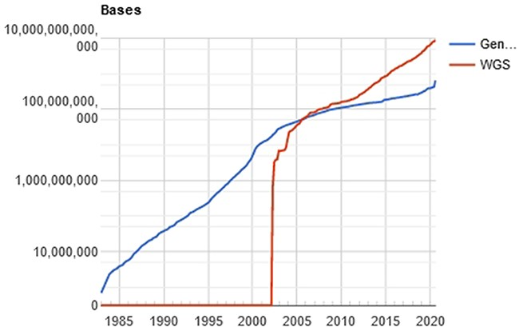
Figure 2. Evolution of the GenBank database, maintained by the NCBI. showing an increase in the curve of genomic data ...
Notes:
Figure 2. Evolution of the GenBank database, maintained by the NCBI. showing an increase in the curve of genomic data deposits, which results in computational difficulties of data processing. Source: NBCI statistics webpage.
Unless provided in the caption above, the following copyright applies to the content of this slide: © The Author(s) 2023. Published by Oxford University Press.This is an Open Access article distributed under the terms of the Creative Commons Attribution License (https://creativecommons.org/licenses/by/4.0/), which permits unrestricted reuse, distribution, and reproduction in any medium, provided the original work is properly cited.

Slide 3
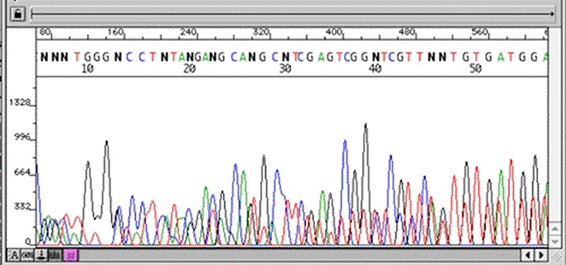
Figure 3. Chromatogram with multiple peaks per base—low quality data. Source: Roswell Park Comprehensive Cancer ...
Notes:
Figure 3. Chromatogram with multiple peaks per base—low quality data. Source: Roswell Park Comprehensive Cancer Center.
Unless provided in the caption above, the following copyright applies to the content of this slide: © The Author(s) 2023. Published by Oxford University Press.This is an Open Access article distributed under the terms of the Creative Commons Attribution License (https://creativecommons.org/licenses/by/4.0/), which permits unrestricted reuse, distribution, and reproduction in any medium, provided the original work is properly cited.

Slide 4
Figure 4. Chromatogram indicating good quality of data sequence. Source: U-M Biomedical Research Core Facilities.
Notes:
Figure 4. Chromatogram indicating good quality of data sequence. Source: U-M Biomedical Research Core Facilities.
Unless provided in the caption above, the following copyright applies to the content of this slide: © The Author(s) 2023. Published by Oxford University Press.This is an Open Access article distributed under the terms of the Creative Commons Attribution License (https://creativecommons.org/licenses/by/4.0/), which permits unrestricted reuse, distribution, and reproduction in any medium, provided the original work is properly cited.

Slide 5
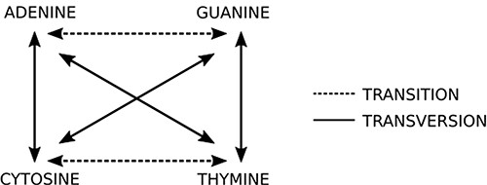
Figure 5. Two basic types of mutations: in transitions there is an exchange of bases of the same class (purine or ...
Notes:
Figure 5. Two basic types of mutations: in transitions there is an exchange of bases of the same class (purine or pyrimidine), while in transversions there is an exchange of bases of different classes. Source: the authors.
Unless provided in the caption above, the following copyright applies to the content of this slide: © The Author(s) 2023. Published by Oxford University Press.This is an Open Access article distributed under the terms of the Creative Commons Attribution License (https://creativecommons.org/licenses/by/4.0/), which permits unrestricted reuse, distribution, and reproduction in any medium, provided the original work is properly cited.

Slide 6
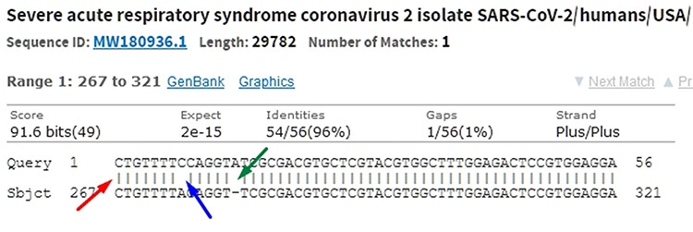
Figure 6. In the alignment of genetic sequences, mismatches (blue), indels (green) and matches (red) can occur. The ...
Notes:
Figure 6. In the alignment of genetic sequences, mismatches (blue), indels (green) and matches (red) can occur. The occurrence of these events does not necessarily mean that they are different subjects. Source: the authors (sample on NCBI Blast).
Unless provided in the caption above, the following copyright applies to the content of this slide: © The Author(s) 2023. Published by Oxford University Press.This is an Open Access article distributed under the terms of the Creative Commons Attribution License (https://creativecommons.org/licenses/by/4.0/), which permits unrestricted reuse, distribution, and reproduction in any medium, provided the original work is properly cited.

Slide 7
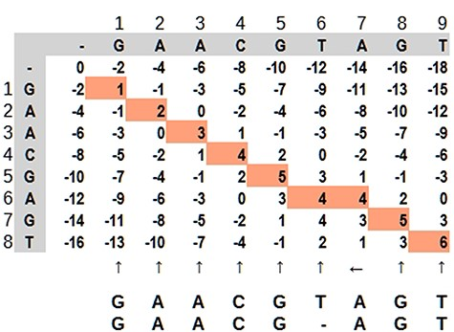
Figure 7. Dynamic programming illustrated by a matrix ‘mn,’ where the highlighted path represents the optimal alignment ...
Notes:
Figure 7. Dynamic programming illustrated by a matrix ‘mn,’ where the highlighted path represents the optimal alignment between the sequences. Source: the authors, based on (25).
Unless provided in the caption above, the following copyright applies to the content of this slide: © The Author(s) 2023. Published by Oxford University Press.This is an Open Access article distributed under the terms of the Creative Commons Attribution License (https://creativecommons.org/licenses/by/4.0/), which permits unrestricted reuse, distribution, and reproduction in any medium, provided the original work is properly cited.

Slide 8
Figure 8. Hypothetical reads. The bases in red are used as a distance marker (green line). The result, in blue, makes ...
Notes:
Figure 8. Hypothetical reads. The bases in red are used as a distance marker (green line). The result, in blue, makes up the sequence identity. Source: the authors.
Unless provided in the caption above, the following copyright applies to the content of this slide: © The Author(s) 2023. Published by Oxford University Press.This is an Open Access article distributed under the terms of the Creative Commons Attribution License (https://creativecommons.org/licenses/by/4.0/), which permits unrestricted reuse, distribution, and reproduction in any medium, provided the original work is properly cited.

Slide 9
Figure 9. Example of a possible wave and its frequency. SARS-CoV-2 reference sample read from NCBI Sequence Read ...
Notes:
Figure 9. Example of a possible wave and its frequency. SARS-CoV-2 reference sample read from NCBI Sequence Read Archive (SAR): ERR4329467.
Unless provided in the caption above, the following copyright applies to the content of this slide: © The Author(s) 2023. Published by Oxford University Press.This is an Open Access article distributed under the terms of the Creative Commons Attribution License (https://creativecommons.org/licenses/by/4.0/), which permits unrestricted reuse, distribution, and reproduction in any medium, provided the original work is properly cited.

Slide 10
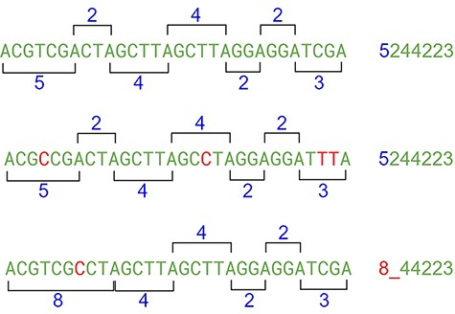
Figure 10. The indel problem. Source: the authors.
Notes:
Figure 10. The indel problem. Source: the authors.
Unless provided in the caption above, the following copyright applies to the content of this slide: © The Author(s) 2023. Published by Oxford University Press.This is an Open Access article distributed under the terms of the Creative Commons Attribution License (https://creativecommons.org/licenses/by/4.0/), which permits unrestricted reuse, distribution, and reproduction in any medium, provided the original work is properly cited.

Slide 11
Figure 11. Partial result of the algorithm. Source: the authors.
Notes:
Figure 11. Partial result of the algorithm. Source: the authors.
Unless provided in the caption above, the following copyright applies to the content of this slide: © The Author(s) 2023. Published by Oxford University Press.This is an Open Access article distributed under the terms of the Creative Commons Attribution License (https://creativecommons.org/licenses/by/4.0/), which permits unrestricted reuse, distribution, and reproduction in any medium, provided the original work is properly cited.

Slide 12
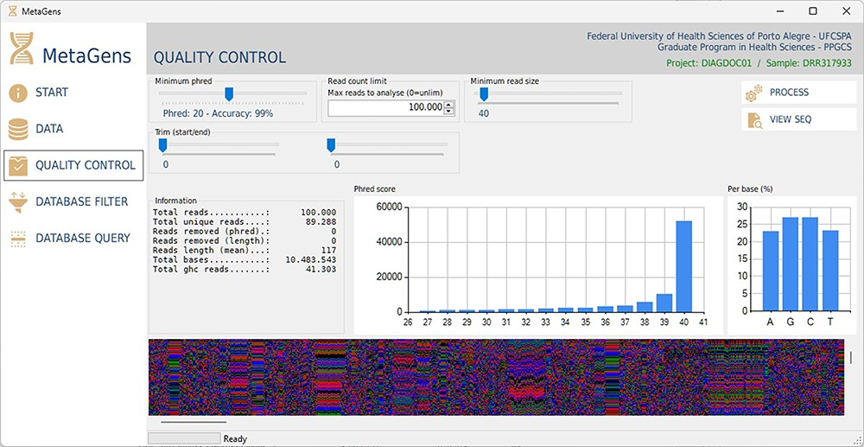
Figure 12. Graphical interface of the MetaGens software showing the quality control panel. It is a user-friendly ...
Notes:
Figure 12. Graphical interface of the MetaGens software showing the quality control panel. It is a user-friendly interface that allows the specification of the quality control parameters. Source: the authors.
Unless provided in the caption above, the following copyright applies to the content of this slide: © The Author(s) 2023. Published by Oxford University Press.This is an Open Access article distributed under the terms of the Creative Commons Attribution License (https://creativecommons.org/licenses/by/4.0/), which permits unrestricted reuse, distribution, and reproduction in any medium, provided the original work is properly cited.

Slide 13
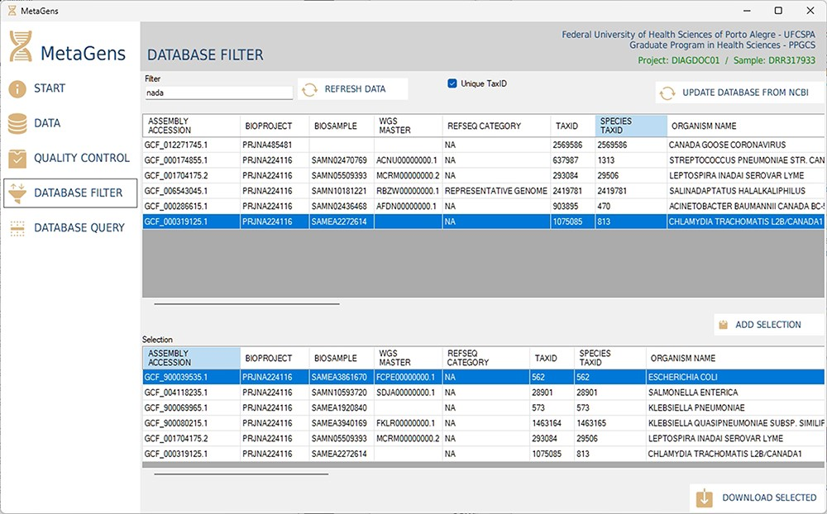
Figure 13. Graphical interface of the MetaGens software showing the database filter panel. When filtering the reference ...
Notes:
Figure 13. Graphical interface of the MetaGens software showing the database filter panel. When filtering the reference sequences, it is possible to reduce the size of the database in order to reduce the analysis time. Source: the authors.
Unless provided in the caption above, the following copyright applies to the content of this slide: © The Author(s) 2023. Published by Oxford University Press.This is an Open Access article distributed under the terms of the Creative Commons Attribution License (https://creativecommons.org/licenses/by/4.0/), which permits unrestricted reuse, distribution, and reproduction in any medium, provided the original work is properly cited.

Slide 14
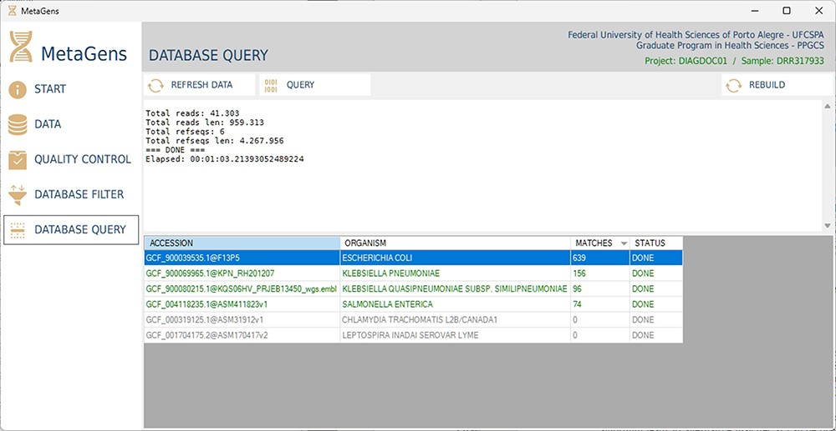
Figure 14. Graphical interface of the MetaGens software showing the database query panel. On the query screen, it is ...
Notes:
Figure 14. Graphical interface of the MetaGens software showing the database query panel. On the query screen, it is possible to follow the progress of the alignment. The table shows the subjects under analysis and their matches. Source: the authors.
Unless provided in the caption above, the following copyright applies to the content of this slide: © The Author(s) 2023. Published by Oxford University Press.This is an Open Access article distributed under the terms of the Creative Commons Attribution License (https://creativecommons.org/licenses/by/4.0/), which permits unrestricted reuse, distribution, and reproduction in any medium, provided the original work is properly cited.

