Slide 1
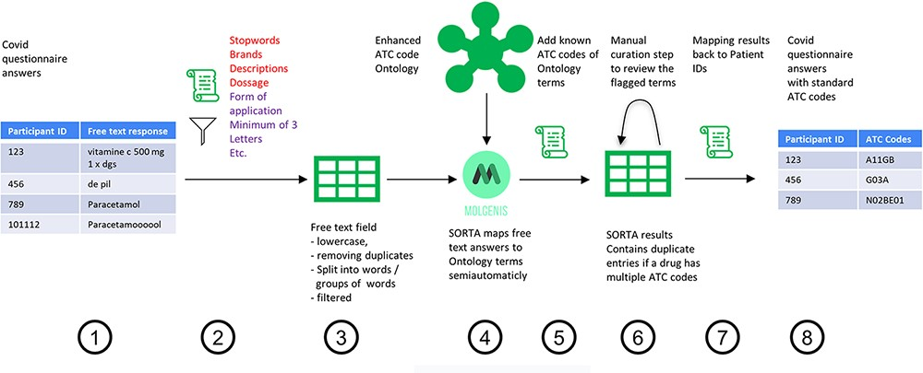
Figure 1. Process overview on how to get from the free-text answers to ATC codes. We pre-processed the COVID-19 ...
Notes:
Figure 1. Process overview on how to get from the free-text answers to ATC codes. We pre-processed the COVID-19 questionnaire answers (Step 1) by first removing participant IDs to anonymize the data, then removing duplicates and unnecessary information and splitting the answer into single terms (Step 2). The result is a list of slightly filtered, unique free-text answers (Step 3). Expert users can then use SORTA to assign ontology terms to each free-text answer (Step 4). Based on a confidence threshold, users can automatically accept assignments. The extended SORTA 2.0 user interface also has the option to flag terms for manual curation, to fix less confident assignments afterwards. After downloading SORTA results, a script can automatically assign the ATC codes (Step 5) to the ontology terms. The cases that could not be solved within SORTA and therefore were flagged for manual curation can be processed by a human expert (Step 6). After manual curation of the more complex cases, the final step (Step 7) recombines the ATC codes with the participant IDs to produce a table with participant IDs and corresponding medication’s standardized ATC code(s) (Step 8).
Unless provided in the caption above, the following copyright applies to the content of this slide: © The Author(s) 2023. Published by Oxford University Press.This is an Open Access article distributed under the terms of the Creative Commons Attribution License (https://creativecommons.org/licenses/by/4.0/), which permits unrestricted reuse, distribution, and reproduction in any medium, provided the original work is properly cited.

