Slide 1
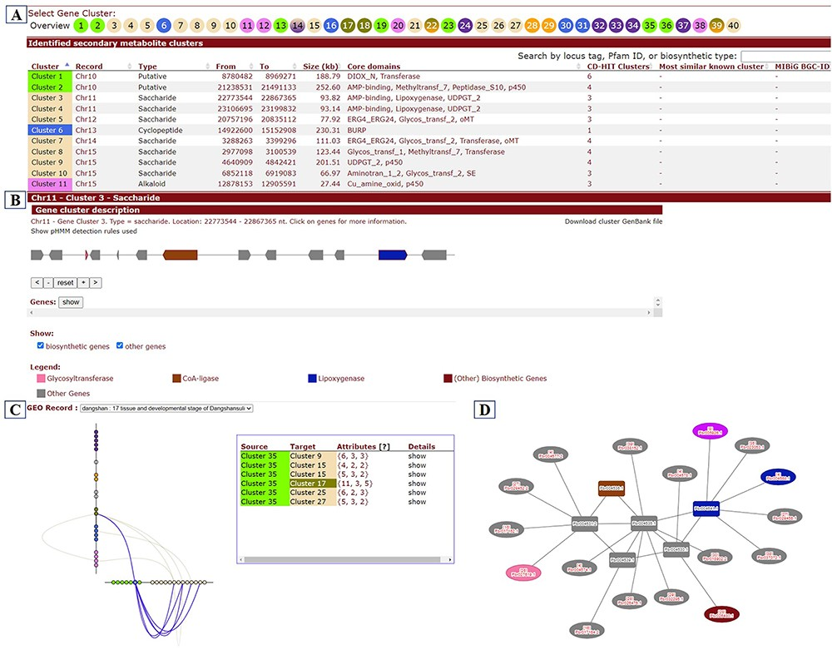
Figure 9. BGCs page. (A) Whole set of BGCs in a pear genome. (B) Gene members and functional characteristics of BGCs. ...
Notes:
Figure 9. BGCs page. (A) Whole set of BGCs in a pear genome. (B) Gene members and functional characteristics of BGCs. (C) Co-expression relationships between BGCs. (D) Co-expression network of genes within a selected cluster (rectangle) and their co-expression relationships with genes from other clusters (ellipse).
Unless provided in the caption above, the following copyright applies to the content of this slide: © The Author(s) 2023. Published by Oxford University Press.This is an Open Access article distributed under the terms of the Creative Commons Attribution License (https://creativecommons.org/licenses/by/4.0/), which permits unrestricted reuse, distribution, and reproduction in any medium, provided the original work is properly cited.

