Slide 1
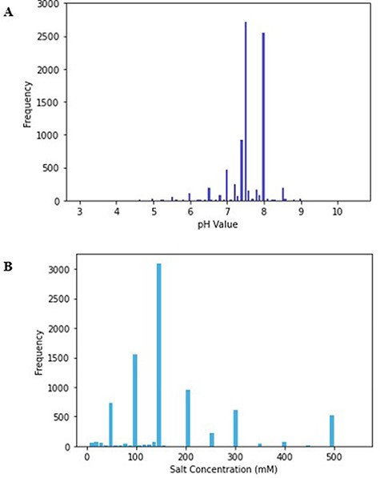
Figure 1. (A) Histogram of pH values in PurificationDB. (B) Histogram of sodium chloride salt concentration values in ...
Notes:
Figure 1. (A) Histogram of pH values in PurificationDB. (B) Histogram of sodium chloride salt concentration values in PurificationDB.
Unless provided in the caption above, the following copyright applies to the content of this slide: © The Author(s) 2023. Published by Oxford University Press.This is an Open Access article distributed under the terms of the Creative Commons Attribution License (https://creativecommons.org/licenses/by/4.0/), which permits unrestricted reuse, distribution, and reproduction in any medium, provided the original work is properly cited.

Slide 2
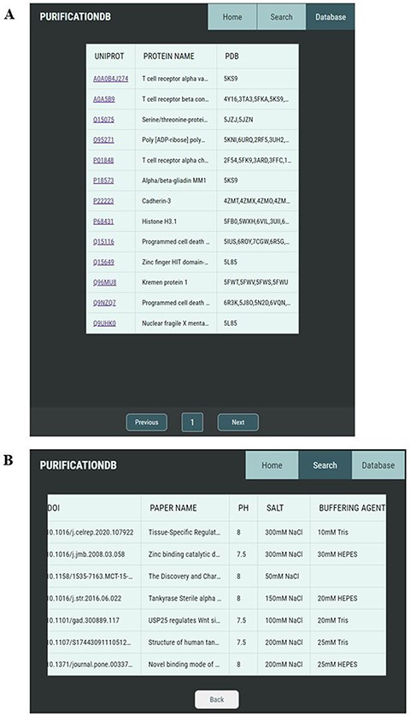
Figure 2. Pages of PurificationDB. (A) On the ‘Database’ page, users can browse entries of the database, labeled with ...
Notes:
Figure 2. Pages of PurificationDB. (A) On the ‘Database’ page, users can browse entries of the database, labeled with their name, UniProt ID, and associated PDB IDs. (B) Upon selection of a UniProt entry O95271, entries from PurificationDB corresponding to this protein are displayed. In this case, we can see that there are several sets of buffer conditions published.
Unless provided in the caption above, the following copyright applies to the content of this slide: © The Author(s) 2023. Published by Oxford University Press.This is an Open Access article distributed under the terms of the Creative Commons Attribution License (https://creativecommons.org/licenses/by/4.0/), which permits unrestricted reuse, distribution, and reproduction in any medium, provided the original work is properly cited.

