Slide 1
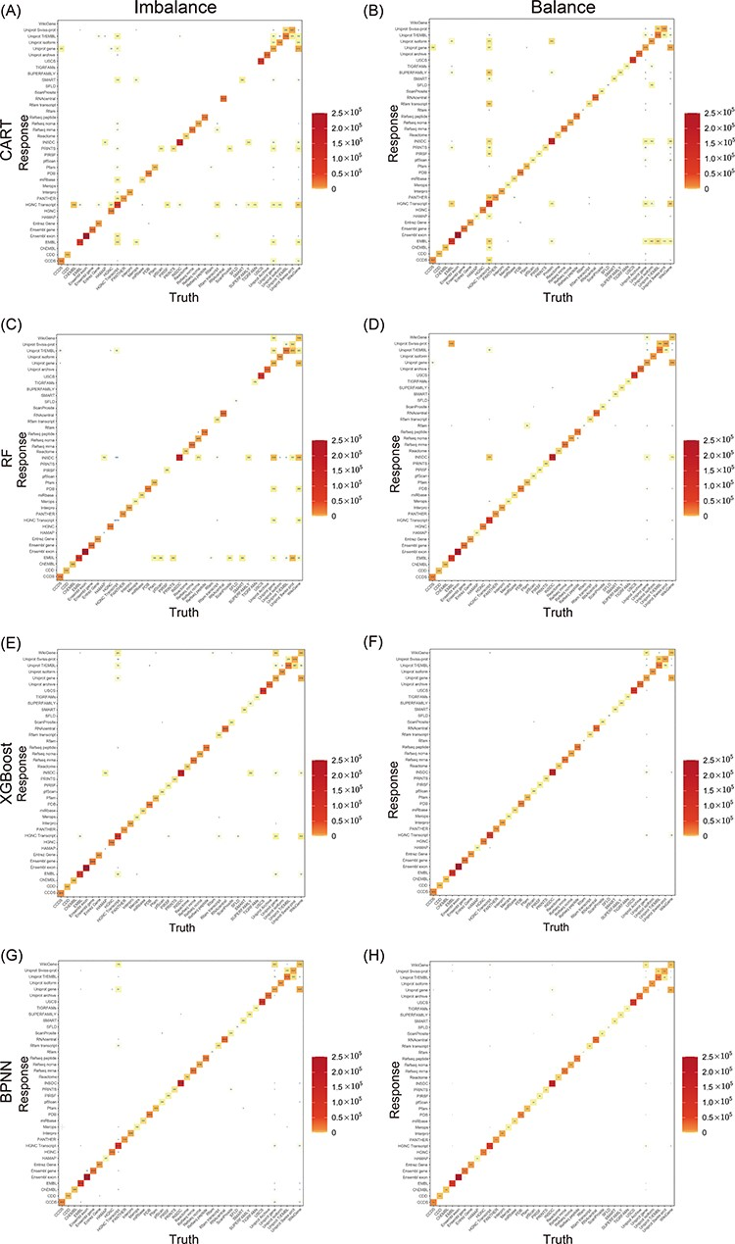
Figure 4. Heat maps of the CMs for models. CART, RF, XGBoost and BPNN, which were trained on both balanced and ...
Notes:
Figure 4. Heat maps of the CMs for models. CART, RF, XGBoost and BPNN, which were trained on both balanced and unbalanced data, are included. The number of truth-prediction pairs is shown by the value in the box. The more the model is accurate, the more the values are concentrated on the diagonal. Through comparing models with and without balancing samples, we discovered that while accuracy did not noticeably improve as a result of balancing datasets, the models performed better for minor classes.
Unless provided in the caption above, the following copyright applies to the content of this slide: © The Author(s) 2023. Published by Oxford University Press.This is an Open Access article distributed under the terms of the Creative Commons Attribution License (https://creativecommons.org/licenses/by/4.0/), which permits unrestricted reuse, distribution, and reproduction in any medium, provided the original work is properly cited.

