Slide 1
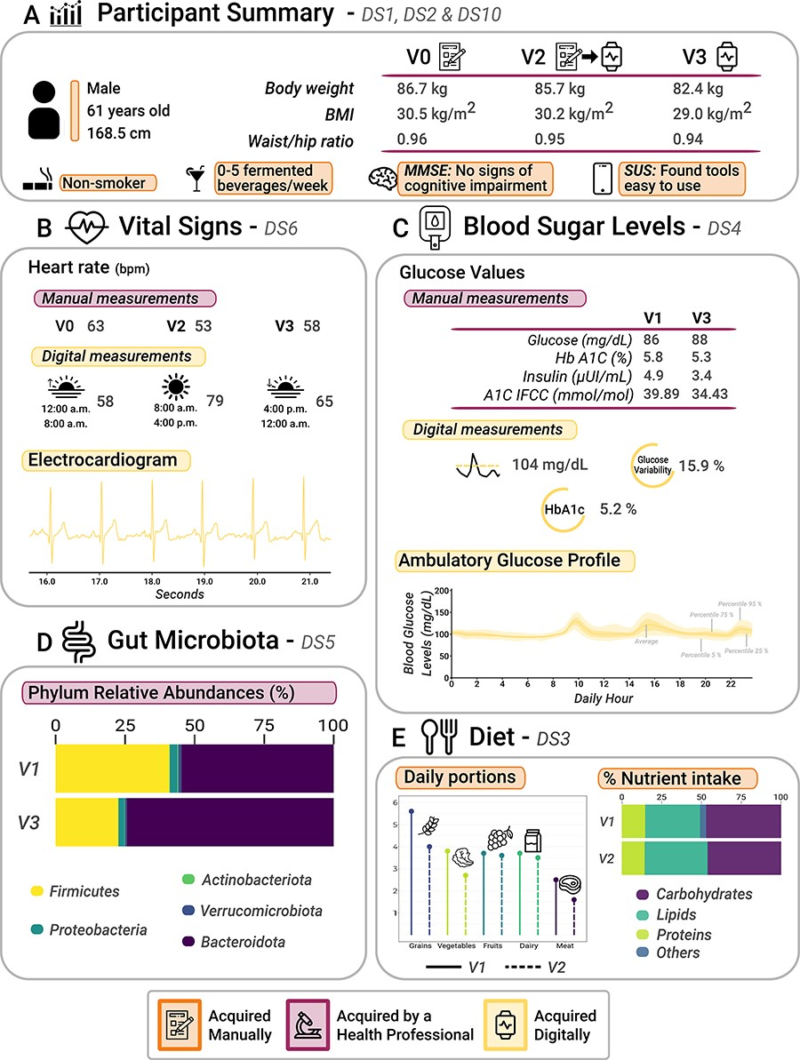
Figure 3.1 Graphical analysis of participant data (a 61-year-old male) collected from AI4FoodDB during the clinical ...
Notes:
Figure 3.1 Graphical analysis of participant data (a 61-year-old male) collected from AI4FoodDB during the clinical intervention. (A) Participant summary, which includes anthropometric measurements from the three visits and additional information (extracted from Datasets 1, 2 and 10). (B) Vital signs associated with manual and digital measurements (Dataset 6). (C) Blood sugar levels, which include manual and digital measurements (Dataset 4). (D) Gut microbiota: relative abundances of the five most abundant phyla at V1 and V3 (Dataset 5). (E) Diet (Dataset 3).
Unless provided in the caption above, the following copyright applies to the content of this slide: © The Author(s) 2023. Published by Oxford University Press.This is an Open Access article distributed under the terms of the Creative Commons Attribution License (https://creativecommons.org/licenses/by/4.0/), which permits unrestricted reuse, distribution, and reproduction in any medium, provided the original work is properly cited.

