Slide 1
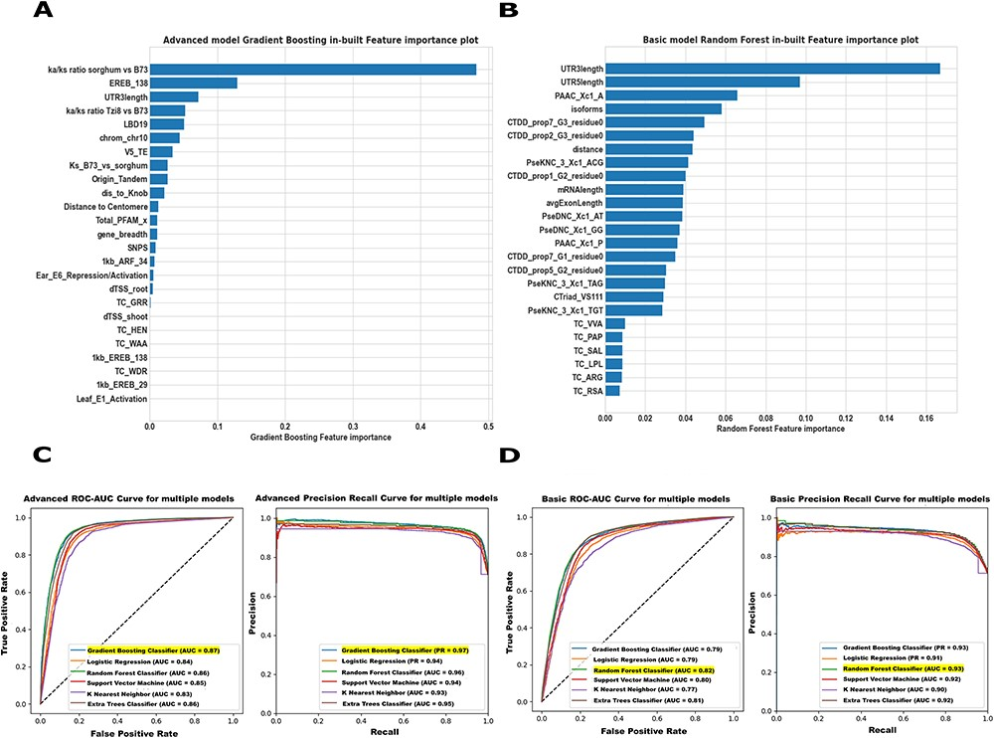
Figure 3. Maize Feature Store example Basic and Advanced models. (A) In our Advanced model, both intrinsic and ...
Notes:
Figure 3. Maize Feature Store example Basic and Advanced models. (A) In our Advanced model, both intrinsic and extrinsic features contributed substantially to the core/non-core gene predictions in maize B73v5. The 25 omics features were ranked based on how useful the model found each feature in predicting the target (core/non-core genes). (B) The Basic model feature importance plot displays only the structural and sequence features most predictive of identifying the core and non-core genes in B73v5. Higher scores indicate that a specific feature has a larger impact on the model used to predict a specific variable (core/non-core). (C, D) The prediction performance of both the ‘Advanced’ model and the ‘Basic’ model was evaluated across all classifiers on the test set using AUC-ROC (left) and the area under the Precision-Recall Curve AUC-PR (right) metrics. For detailed model evaluation and performance analysis, see the Supplementary Figure S17-S18.
Unless provided in the caption above, the following copyright applies to the content of this slide: Published by Oxford University Press 2023. This work is written by (a) US Government employee(s) and is in the public domain in the US.This work is written by (a) US Government employee(s) and is in the public domain in the US.

