Slide 1
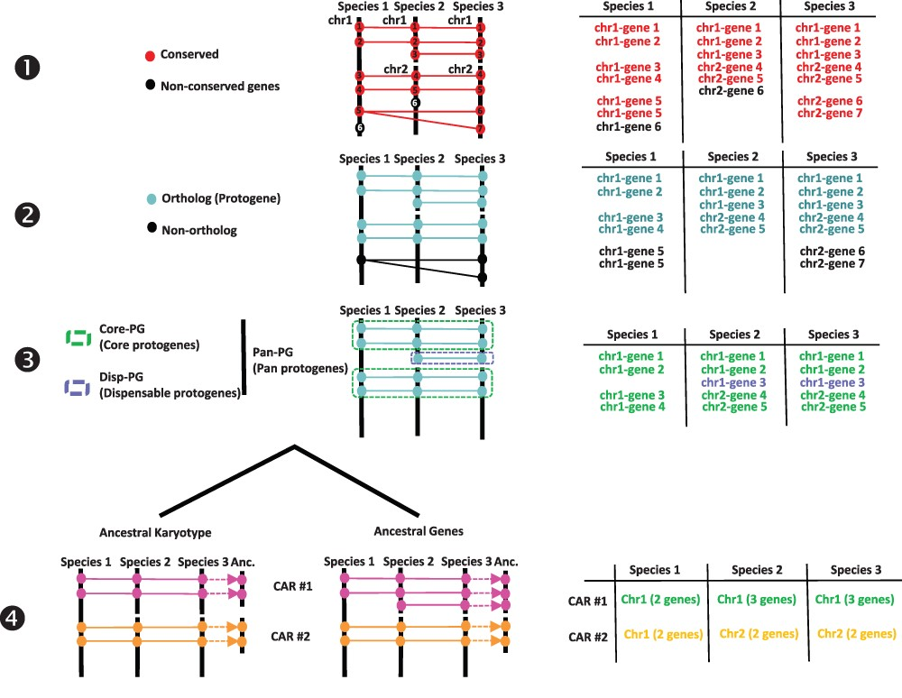
Figure 1. Procedure for reconstructing ancestral karyotypes. Ancestral genomes are inferred from (see the Materials and ...
Notes:
Figure 1. Procedure for reconstructing ancestral karyotypes. Ancestral genomes are inferred from (see the Materials and methods section) conserved genes (Step 1), orthologous relationships (Step 2), SBs (Step 3) and CARs (Step 4), to provide the best scenario explaining the transition between ancestral and modern genomes. Types of tabular files derived from each step are illustrated at the right to help readers to properly follow the procedure (described in and adapted from (20)).
Unless provided in the caption above, the following copyright applies to the content of this slide: © The Author(s) 2023. Published by Oxford University Press.This is an Open Access article distributed under the terms of the Creative Commons Attribution License (https://creativecommons.org/licenses/by/4.0/), which permits unrestricted reuse, distribution, and reproduction in any medium, provided the original work is properly cited.

