Slide 1
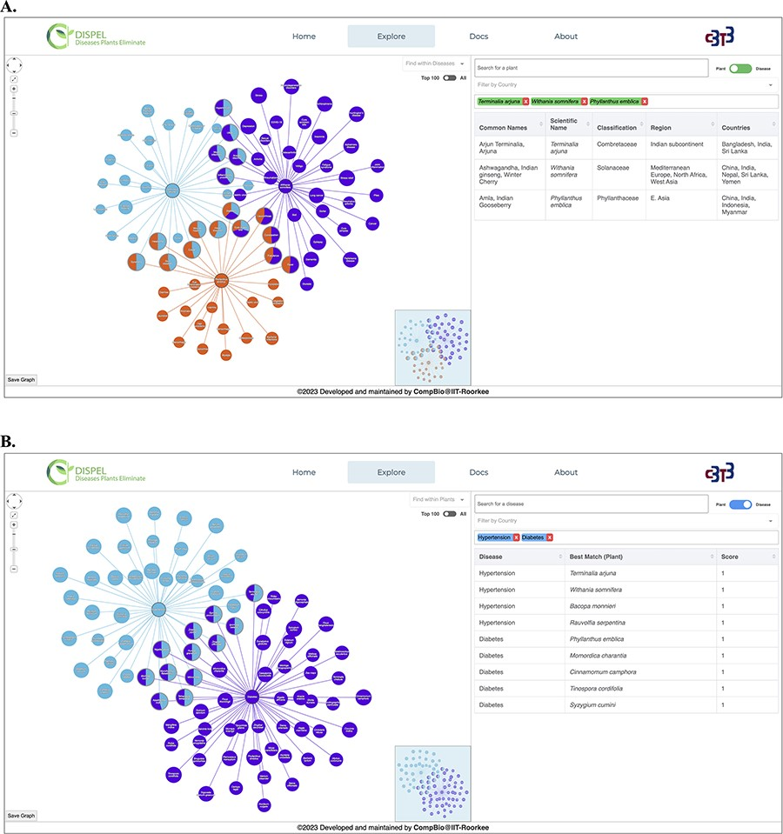
Figure 3. (A) Representative output of ‘Plant Search’ using three medicinal plants (center nodes): Terminalia arjuna ...
Notes:
Figure 3. (A) Representative output of ‘Plant Search’ using three medicinal plants (center nodes): Terminalia arjuna (Arjuna, light blue), Withania somnifera (Ashwagandha, purple) and Phyllanthus emblica (Amla, orange). The diseases are shown as leaf/edge nodes. (B) Representative output of ‘Disease Search’ using two diseases (center nodes): hypertension (light blue) and diabetes (purple).
Unless provided in the caption above, the following copyright applies to the content of this slide: © The Author(s) 2023. Published by Oxford University Press.This is an Open Access article distributed under the terms of the Creative Commons Attribution License (https://creativecommons.org/licenses/by/4.0/), which permits unrestricted reuse, distribution, and reproduction in any medium, provided the original work is properly cited.

Slide 2
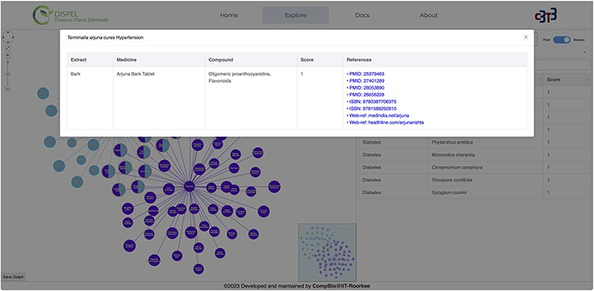
Figure 4. Clicking on the ‘Terminalia arjuna-hypertension’ link/edge displays the relevant information about the ...
Notes:
Figure 4. Clicking on the ‘Terminalia arjuna-hypertension’ link/edge displays the relevant information about the extract (part of plant), medicine, compound, score and references.
Unless provided in the caption above, the following copyright applies to the content of this slide: © The Author(s) 2023. Published by Oxford University Press.This is an Open Access article distributed under the terms of the Creative Commons Attribution License (https://creativecommons.org/licenses/by/4.0/), which permits unrestricted reuse, distribution, and reproduction in any medium, provided the original work is properly cited.

Slide 3
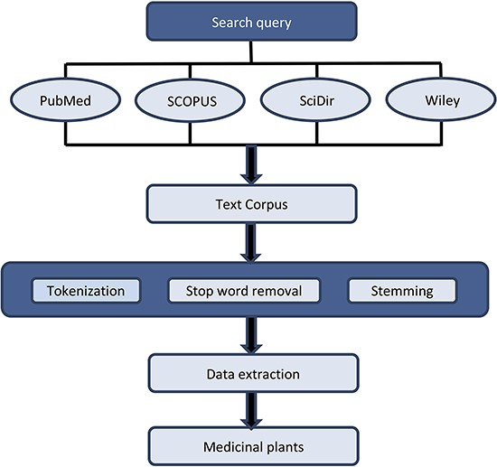
Figure 2. Flow chart of data preprocessing and extraction. Preprocessing involves three main steps: (i) Tokenization, ...
Notes:
Figure 2. Flow chart of data preprocessing and extraction. Preprocessing involves three main steps: (i) Tokenization, (ii) Stop word removal and (iii) Stemming. For data extraction, Python and Natural Language Toolkit were used.
Unless provided in the caption above, the following copyright applies to the content of this slide: © The Author(s) 2023. Published by Oxford University Press.This is an Open Access article distributed under the terms of the Creative Commons Attribution License (https://creativecommons.org/licenses/by/4.0/), which permits unrestricted reuse, distribution, and reproduction in any medium, provided the original work is properly cited.

Slide 4
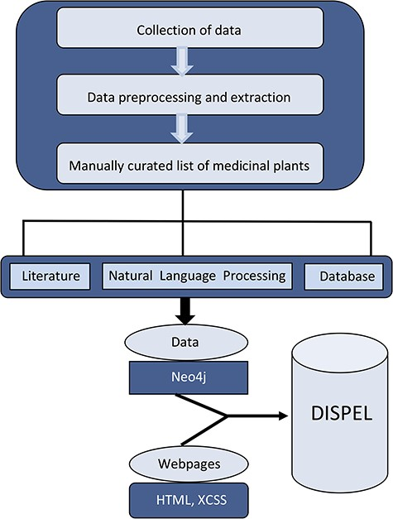
Figure 1. Schematic representation of overall strategy used in the construction of DISPEL database.
Notes:
Figure 1. Schematic representation of overall strategy used in the construction of DISPEL database.
Unless provided in the caption above, the following copyright applies to the content of this slide: © The Author(s) 2023. Published by Oxford University Press.This is an Open Access article distributed under the terms of the Creative Commons Attribution License (https://creativecommons.org/licenses/by/4.0/), which permits unrestricted reuse, distribution, and reproduction in any medium, provided the original work is properly cited.

