Slide 1
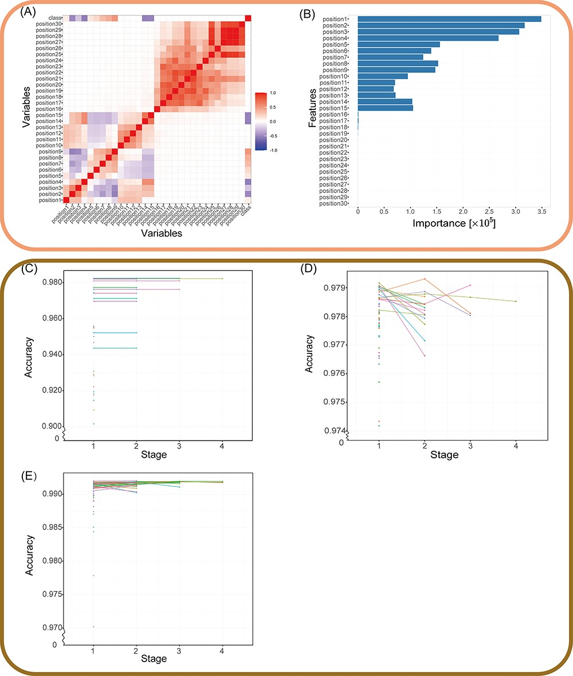
Figure 3. Validation of the MantaID model performance. (A and B) The result of features selection. (A) Correlation heat ...
Notes:
Figure 3. Validation of the MantaID model performance. (A and B) The result of features selection. (A) Correlation heat map. Positive values mean positive correlation; negative values mean negative correlation, as evaluated by Pearson's correlation test. (B) Features importance computed by RF. The horizontal coordinate is the Gini impurity, an indicator for evaluating importance, and the vertical coordinate is the feature. Stage plot for Hyperband tuning of (C) CART, (D) RF and (E) XGBoost. Each line or point represents a set of related parameters, and Hyperband algorithm discards configurations with a percentage of ${\rm{\;}}\frac{1}{\eta }$ to cut training time. Notably, the cart model’s polygon line appears to be stagnating as a result of the minimal accuracy change between stages when compared to the span.
Unless provided in the caption above, the following copyright applies to the content of this slide: © The Author(s) 2023. Published by Oxford University Press.This is an Open Access article distributed under the terms of the Creative Commons Attribution License (https://creativecommons.org/licenses/by/4.0/), which permits unrestricted reuse, distribution, and reproduction in any medium, provided the original work is properly cited.

