Slide 1
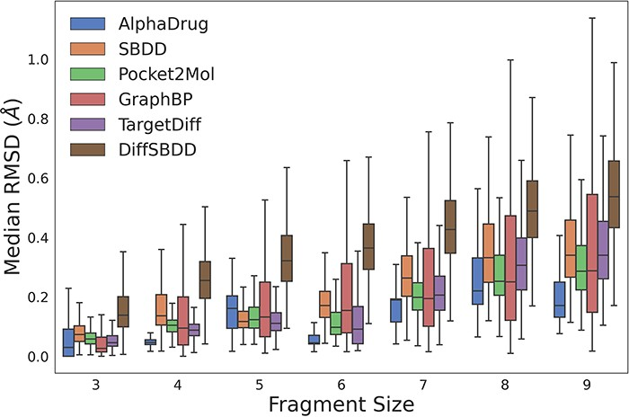
Figure 1. The RMSD values between coordinates of rigid fragments before and after force field optimization. A smaller ...
Notes:
Figure 1. The RMSD values between coordinates of rigid fragments before and after force field optimization. A smaller RMSD value denotes a more reasonable sub-structure. Alt text: The image is a boxplot graph representing the median RMSD across different fragment sizes for various drug discovery methods. Each boxplot corresponds to a specific method, color-coded for identification, with fragment sizes on the x-axis and median RMSD values on the y-axis.
Unless provided in the caption above, the following copyright applies to the content of this slide: © The Author(s) 2023. Published by Oxford University Press.This is an Open Access article distributed under the terms of the Creative Commons Attribution License (https://creativecommons.org/licenses/by/4.0/), which permits unrestricted reuse, distribution, and reproduction in any medium, provided the original work is properly cited.

