Slide 1
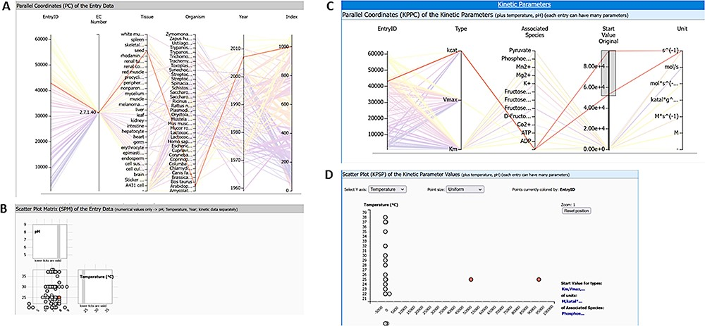
Figure 9. Query results for enzyme pyruvate kinase and reaction ‘ATP + Pyruvate = ADP + Phosphoenolpyruvate’ (query ...
Notes:
Figure 9. Query results for enzyme pyruvate kinase and reaction ‘ATP + Pyruvate = ADP + Phosphoenolpyruvate’ (query term: ECNumber:”2.7.1.40” AND SabioReactionID:”9”) with two highlighted kinetic parameter outlier values: (A) parallel coordinates of entry data, (B) scatter plot matrix of entry data, (C) parallel coordinates of kinetic parameters, and (D) scatter plot of kinetic parameters.
Unless provided in the caption above, the following copyright applies to the content of this slide: © The Author(s) 2023. Published by Oxford University Press.This is an Open Access article distributed under the terms of the Creative Commons Attribution License (https://creativecommons.org/licenses/by/4.0/), which permits unrestricted reuse, distribution, and reproduction in any medium, provided the original work is properly cited.

