Slide 1
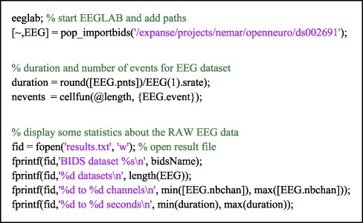
Figure 5. An example MATLAB script running on NSG using OpenNeuro/NEMAR dataset ds002691. The script, submitted by a ...
Notes:
Figure 5. An example MATLAB script running on NSG using OpenNeuro/NEMAR dataset ds002691. The script, submitted by a user through the NSG interface, is executed on the Expanse supercomputer, for which the NEMAR datasets are immediately accessible via their ‘ds’ index (as below).
Unless provided in the caption above, the following copyright applies to the content of this slide: © The Author(s) 2022. Published by Oxford University Press.This is an Open Access article distributed under the terms of the Creative Commons Attribution-NonCommercial License (https://creativecommons.org/licenses/by-nc/4.0/), which permits non-commercial re-use, distribution, and reproduction in any medium, provided the original work is properly cited. For commercial re-use, please contact journals.permissions@oup.com

