Slide 1
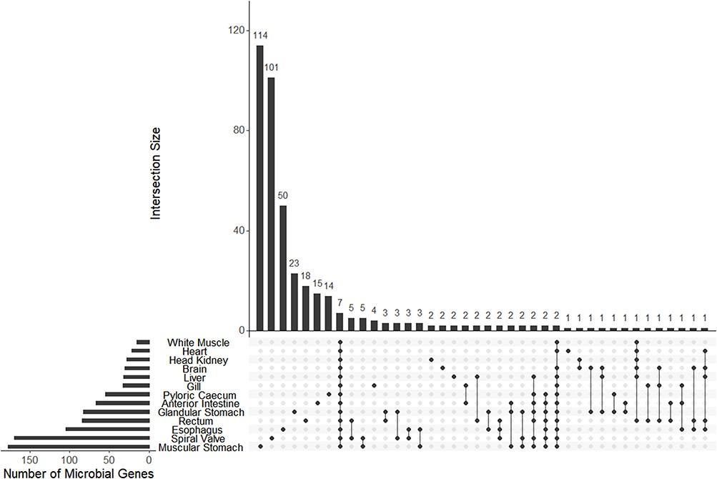
Figure 5. The UpSet plot of shared and unique genes annotated to microbes (bacteria or archaea) from each of 13 ...
Notes:
Figure 5. The UpSet plot of shared and unique genes annotated to microbes (bacteria or archaea) from each of 13 tissue-specific transcriptomes of the lake sturgeon (Acipenser fulvescens). Annotations were performed with Trinotate, and bacterial or archaeal genes were identified by filtering for those groups among filtered transcriptome annotation reports.
Unless provided in the caption above, the following copyright applies to the content of this slide: © The Author(s) 2023. Published by Oxford University Press.This is an Open Access article distributed under the terms of the Creative Commons Attribution License (https://creativecommons.org/licenses/by/4.0/), which permits unrestricted reuse, distribution, and reproduction in any medium, provided the original work is properly cited.

