Slide 1
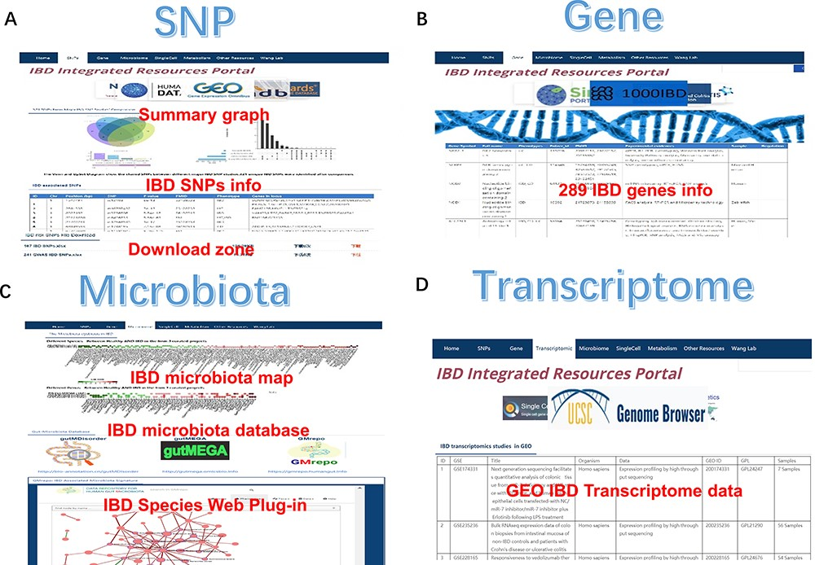
Figure 2. The SNP, gene, microbiota and transcriptome section of IBDIRP. (A) The SNP section conllected more than 320 ...
Notes:
Figure 2. The SNP, gene, microbiota and transcriptome section of IBDIRP. (A) The SNP section conllected more than 320 unique risk SNPs associated with IBD. (B) The gene section displays 289 IBD-related genes based on the database’s collection. (C) The sorted IBD-related microbiota data are available in microbiota section. (D) The transcriptome section displays 153 IBD-related transcriptome data. Alt Text: The brief introduction of SNP, gene, microbiota and transcriptome section in IBDIRP website.
Unless provided in the caption above, the following copyright applies to the content of this slide: © The Author(s) 2024. Published by Oxford University Press.This is an Open Access article distributed under the terms of the Creative Commons Attribution License (https://creativecommons.org/licenses/by/4.0/), which permits unrestricted reuse, distribution, and reproduction in any medium, provided the original work is properly cited.

