Slide 1
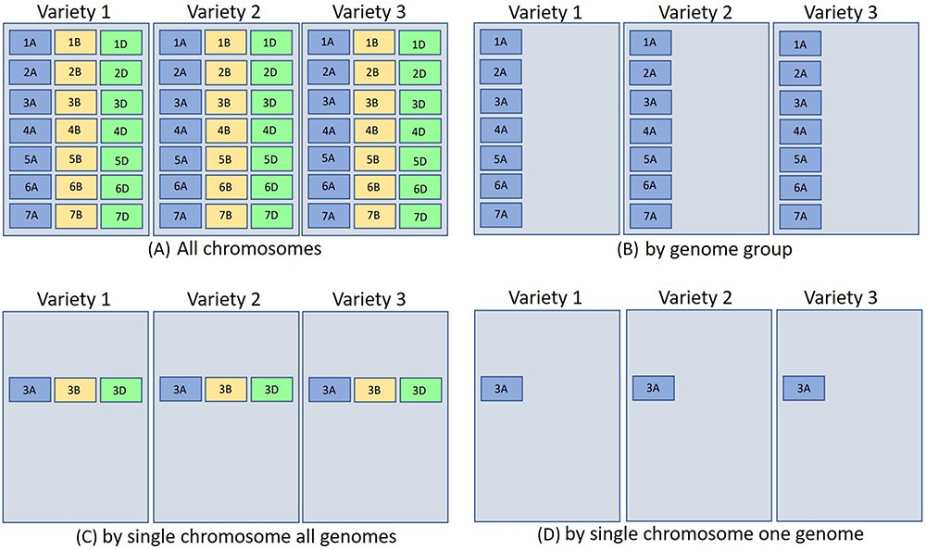
Figure 7. The above represents three different hexaploid wheat cultivars BLAST database sets searched by four different ...
Notes:
Figure 7. The above represents three different hexaploid wheat cultivars BLAST database sets searched by four different parameters [only the (a) quadrant contains all chromosomes for hexaploid wheat]. The other quadrants are partitioned by (b) genome group (1–7A genome), (c) single chromosome all genomes (3ABD), and (d) single chromosome single genome (3A). Database indexing partitioned in such a fashion for (b–d) takes less time and resources (see text for more explanation). For wheat, each chromosome block would represent about 700 Mb.
Unless provided in the caption above, the following copyright applies to the content of this slide: © The Author(s) 2023. Published by Oxford University Press.This is an Open Access article distributed under the terms of the Creative Commons Attribution License (https://creativecommons.org/licenses/by/4.0/), which permits unrestricted reuse, distribution, and reproduction in any medium, provided the original work is properly cited.

