Slide 1
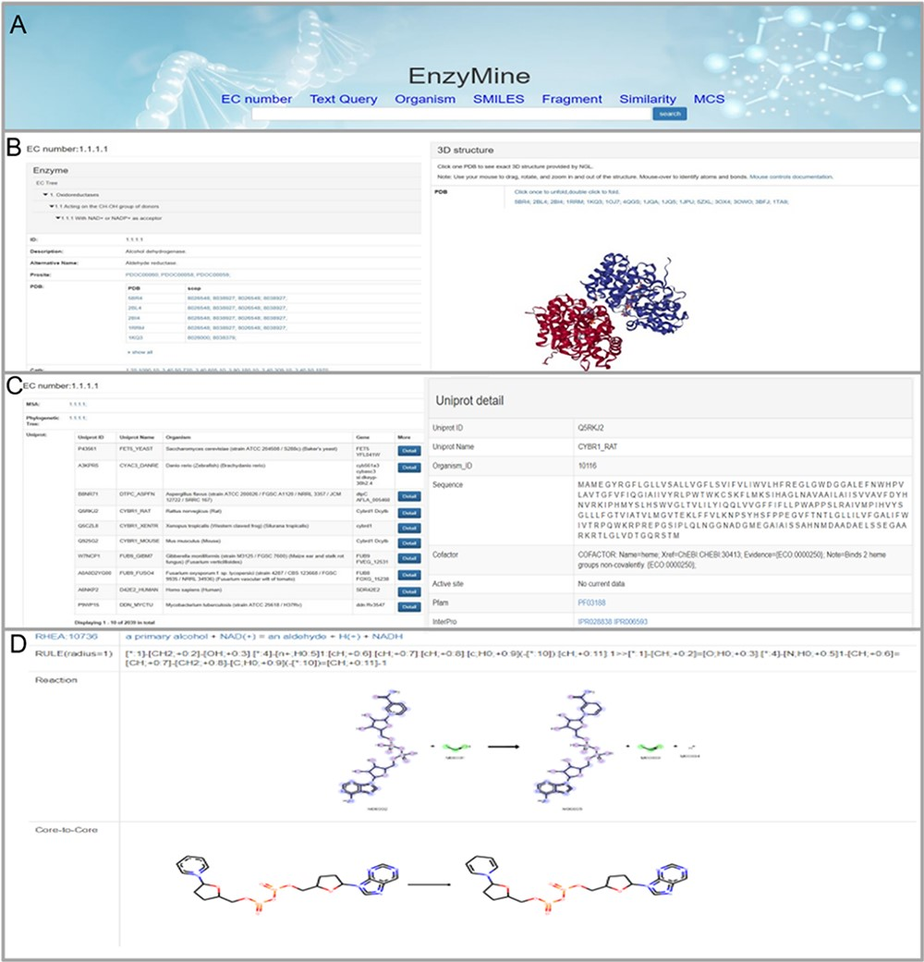
Figure 4. Detailed EnzyMine screenshot and search results for EC:1.1.1.1 are shown. (A) Front-end search methods based ...
Notes:
Figure 4. Detailed EnzyMine screenshot and search results for EC:1.1.1.1 are shown. (A) Front-end search methods based on text query and molecular searching query. (B) Basic enzyme information is listed, where EC classification, PROSITE and CATH classifications are shown on the left. Various display options related to protein 3D structures are provided by the NGL engine (27). (C) Multi-sequence alignment and phylogenetic trees related to the UniProt sequence under each the EC number are provided in a link, and single UniProt details are included by clicking the button on the right. (D) Reaction centre display, rules and core-to-core are shown. Detailed enzyme information and feature mining information are available for download.
Unless provided in the caption above, the following copyright applies to the content of this slide: © The Author(s) 2020. Published by Oxford University Press.This is an Open Access article distributed under the terms of the Creative Commons Attribution License (http://creativecommons.org/licenses/by/4.0/), which permits unrestricted reuse, distribution, and reproduction in any medium, provided the original work is properly cited.

