Slide 1
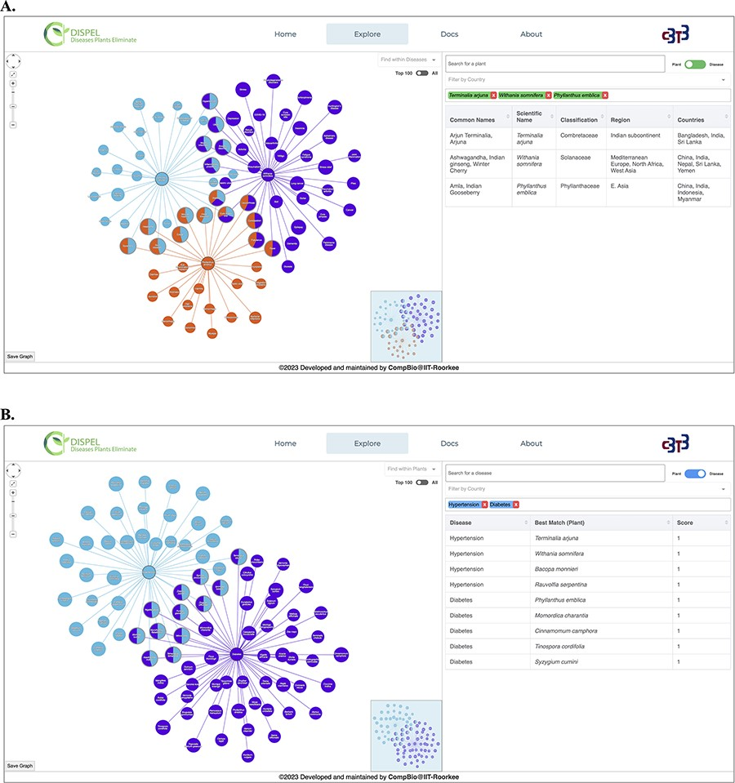
Figure 3. (A) Representative output of ‘Plant Search’ using three medicinal plants (center nodes): Terminalia arjuna ...
Notes:
Figure 3. (A) Representative output of ‘Plant Search’ using three medicinal plants (center nodes): Terminalia arjuna (Arjuna, light blue), Withania somnifera (Ashwagandha, purple) and Phyllanthus emblica (Amla, orange). The diseases are shown as leaf/edge nodes. (B) Representative output of ‘Disease Search’ using two diseases (center nodes): hypertension (light blue) and diabetes (purple).
Unless provided in the caption above, the following copyright applies to the content of this slide: © The Author(s) 2023. Published by Oxford University Press.This is an Open Access article distributed under the terms of the Creative Commons Attribution License (https://creativecommons.org/licenses/by/4.0/), which permits unrestricted reuse, distribution, and reproduction in any medium, provided the original work is properly cited.

