Slide 1
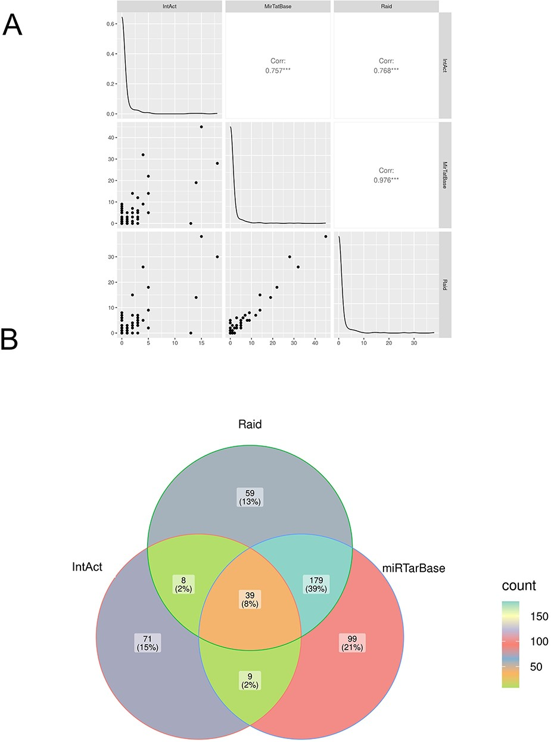
Figure 5. Comparison of microRNA–mRNA interactions annotated in IntAct, MirTarBase and RAID. (A) Correlation analysis: ...
Notes:
Figure 5. Comparison of microRNA–mRNA interactions annotated in IntAct, MirTarBase and RAID. (A) Correlation analysis: the number of microRNA-regulating genes associated with the diseases in the three datasets was compared (see also Supplementary Table 1). (B) Venn diagram comparing interacting pairs of microRNA–mRNA annotated in the three datasets. The Jaccard similarity coefficient (in parentheses) is calculated as intersection over union and indicates that only 8% of the interactions are annotated in all the datasets and that each resource contains some exclusive information.
Unless provided in the caption above, the following copyright applies to the content of this slide: © The Author(s) 2023. Published by Oxford University Press.This is an Open Access article distributed under the terms of the Creative Commons Attribution License (https://creativecommons.org/licenses/by/4.0/), which permits unrestricted reuse, distribution, and reproduction in any medium, provided the original work is properly cited.

