Slide 1
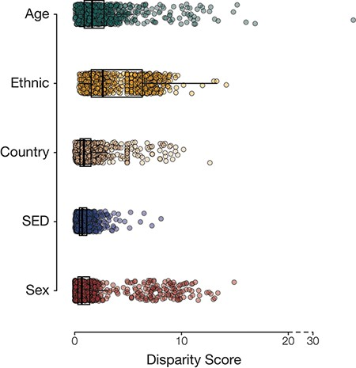
Figure 2. Population group disease disparity scores. The distributions of disease disparity scores for each population ...
Notes:
Figure 2. Population group disease disparity scores. The distributions of disease disparity scores for each population group attribute are shown. Each point is a disease phenotype plotted with its group-specific disparity score.
Unless provided in the caption above, the following copyright applies to the content of this slide: Published by Oxford University Press 2023. This work is written by (a) US Government employee(s) and is in the public domain in the US.This work is written by (a) US Government employee(s) and is in the public domain in the US.

