Slide 1
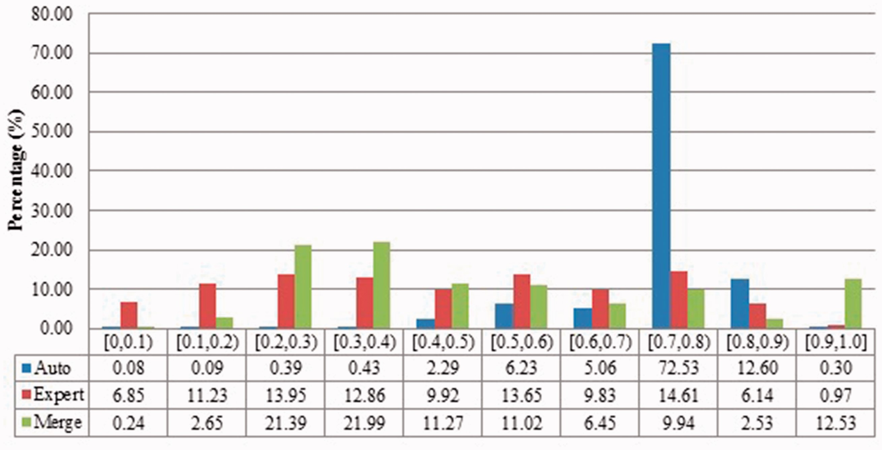
Figure 2 Description similarities of duplicates from Xenopus laevis in three benchmarks: Auto for auto curation based; ...
Notes:
Figure 2 Description similarities of duplicates from Xenopus laevis in three benchmarks: Auto for auto curation based; Expert for expert curation; and Merge for merge-based collection. X-axis defines the similarity range. For instance, [0.5, 0.6) means greater than or equal to 0.5 and <0.6. Y-axis defines the proportion for each similarity range. Submitter similarities of duplicates from Xenopus laevis in three benchmarks. Different: the submitters of records are completely Different; Same: the pair at least shares with at least one submitter; Not specified: no submitter details are specified in REFERENCE field in records by standard. The rest is the same as above. Figure 4.Alignment proportion of duplicates from Xenopus laevis. LOW refers to similarity that is greater than the threshold or NO HITS based on BLAST output. Recall that we chose the parameters to produce reliable BLAST output. Figure 5Local sequence identity of duplicates from Xenopus laevis in three benchmarks. The rest is the same as above. Figure 6Description similarity of duplicates from Zea mays in three benchmarks. Figure 7Submitter similarity of duplicates from Zea mays in three benchmarks. Figure 8Alignment proportion of duplicates from Zea mays in three benchmarks. Figure 9Local sequence identity of duplicates from Zea mays in three benchmarks.
Unless provided in the caption above, the following copyright applies to the content of this slide: © The Author(s) 2017. Published by Oxford University Press.This is an Open Access article distributed under the terms of the Creative Commons Attribution License (http://creativecommons.org/licenses/by/4.0/), which permits unrestricted reuse, distribution, and reproduction in any medium, provided the original work is properly cited.

