Slide 1
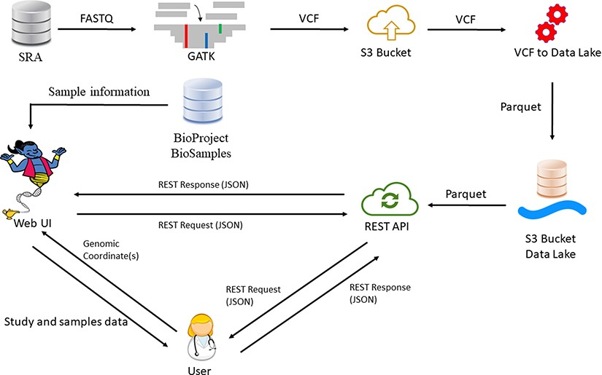
Figure 1. GeniePool workflow. Raw genomic NGS data from SRA are preprocessed according to GATK’s best practices and ...
Notes:
Figure 1. GeniePool workflow. Raw genomic NGS data from SRA are preprocessed according to GATK’s best practices and stored efficiently using the Parquet format in a cloud data lake architecture. Preprocessed data are available via either a REST API or a designated web UI accompanied by BioSample data that provide information regarding specific samples.
Unless provided in the caption above, the following copyright applies to the content of this slide: © The Author(s) 2023. Published by Oxford University Press.This is an Open Access article distributed under the terms of the Creative Commons Attribution License (https://creativecommons.org/licenses/by/4.0/), which permits unrestricted reuse, distribution, and reproduction in any medium, provided the original work is properly cited.

