Slide 1
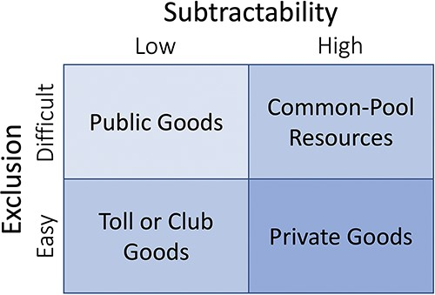
Figure 1. A typology for suitable management approaches to resources, modified from Ostrom et al. (62).
Notes:
Figure 1. A typology for suitable management approaches to resources, modified from Ostrom et al. (62).
Unless provided in the caption above, the following copyright applies to the content of this slide: © The Author(s) 2023. Published by Oxford University Press.This is an Open Access article distributed under the terms of the Creative Commons Attribution License (https://creativecommons.org/licenses/by/4.0/), which permits unrestricted reuse, distribution, and reproduction in any medium, provided the original work is properly cited.

Slide 2
Figure 2. Five epistemic-organizational models for data pooling: data aggregators, search index portals, research ...
Notes:
Figure 2. Five epistemic-organizational models for data pooling: data aggregators, search index portals, research contractors, peer data commons and custom databases. The properties of these models are illustrated by analogous approaches to how businesses or social groups make food for broader consumption. The models rely on data standardization and preprocessing to an increasing degree from left to right.
Unless provided in the caption above, the following copyright applies to the content of this slide: © The Author(s) 2023. Published by Oxford University Press.This is an Open Access article distributed under the terms of the Creative Commons Attribution License (https://creativecommons.org/licenses/by/4.0/), which permits unrestricted reuse, distribution, and reproduction in any medium, provided the original work is properly cited.

Slide 3
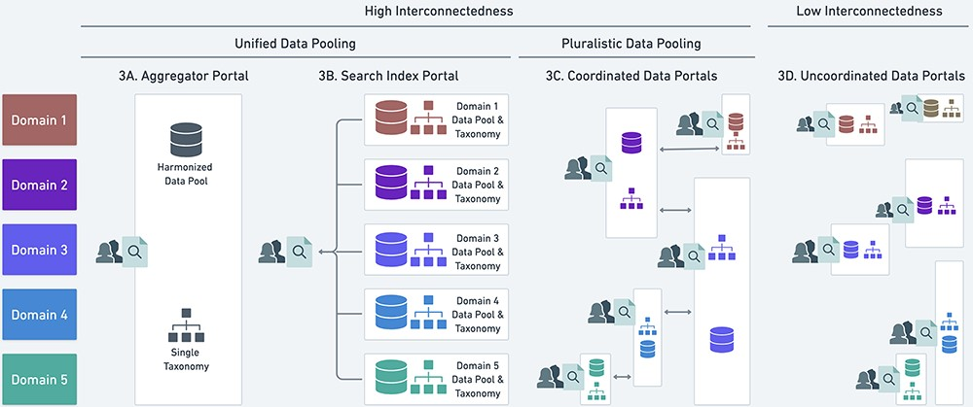
Figure 3. Four possible heuristics (A–D) for data pooling and their relationship to the unified and pluralistic ideals. ...
Notes:
Figure 3. Four possible heuristics (A–D) for data pooling and their relationship to the unified and pluralistic ideals. See main text for discussion of A-D. White boxes represent distinct data portals, and colored symbols within the box represent data standardized to a local, potentially unique taxonomic classification that is not deliberately harmonized with other taxonomies. The vertical overlap in white boxes indicates where portals overlap in the scope of data they include.
Unless provided in the caption above, the following copyright applies to the content of this slide: © The Author(s) 2023. Published by Oxford University Press.This is an Open Access article distributed under the terms of the Creative Commons Attribution License (https://creativecommons.org/licenses/by/4.0/), which permits unrestricted reuse, distribution, and reproduction in any medium, provided the original work is properly cited.

Slide 4
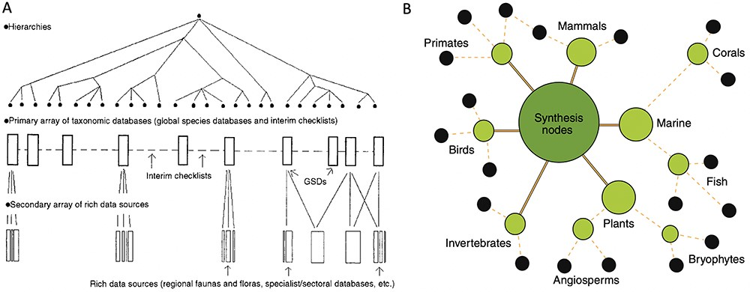
Figure 4. Two heuristic approaches to unified data pooling. (A) Image from Bisby (28), illustrating his envisioned ...
Notes:
Figure 4. Two heuristic approaches to unified data pooling. (A) Image from Bisby (28), illustrating his envisioned unified hierarchy of classificatory theories for taxonomic domains. The hierarchy would enable a centralized aggregator or modular system of data pools. (B) Image from Gallagher et al. (52), illustrating a modular hub-and-spoke system for integrating trait data about species by taxonomic domains. Black circles at the edges of the network show primary data publishers or sources. Intermediate nodes show projects harmonizing data and developing standards. The central, largest node represents a trait dataset registry that functions as a basic search index portal across domains.
Unless provided in the caption above, the following copyright applies to the content of this slide: © The Author(s) 2023. Published by Oxford University Press.This is an Open Access article distributed under the terms of the Creative Commons Attribution License (https://creativecommons.org/licenses/by/4.0/), which permits unrestricted reuse, distribution, and reproduction in any medium, provided the original work is properly cited.

Slide 5
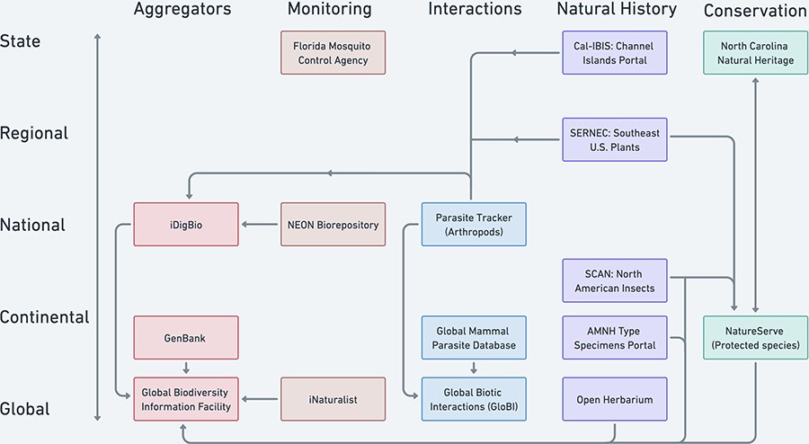
Figure 5. Selected examples of North American and global biodiversity data pooling projects illustrate the current ...
Notes:
Figure 5. Selected examples of North American and global biodiversity data pooling projects illustrate the current partially coordinated flow of biodiversity data (uni- or bi-directional arrows). Projects are distinguished by the geographic scale (y-axis) and type of domain used to characterize their scope (colors by column on the x-axis). The aggregator column represents some important biodiversity data pooling projects whose scopes cut across the other domain categories.
Unless provided in the caption above, the following copyright applies to the content of this slide: © The Author(s) 2023. Published by Oxford University Press.This is an Open Access article distributed under the terms of the Creative Commons Attribution License (https://creativecommons.org/licenses/by/4.0/), which permits unrestricted reuse, distribution, and reproduction in any medium, provided the original work is properly cited.

