Slide 1
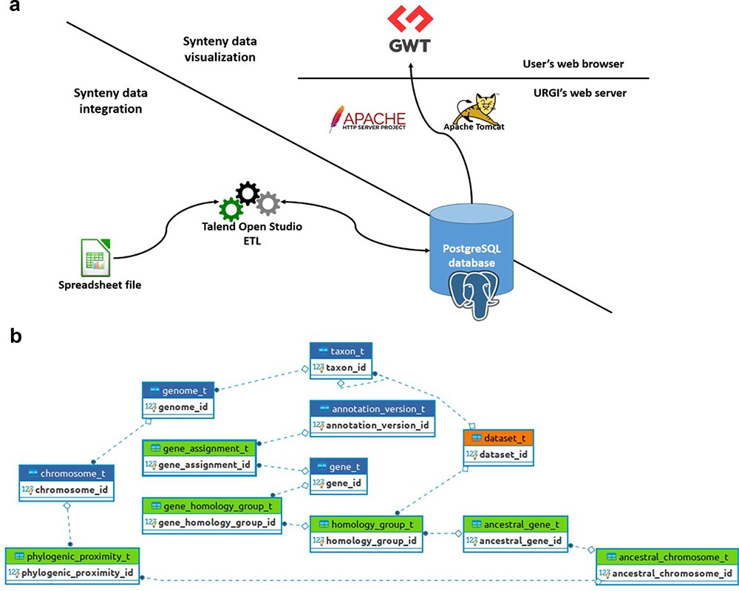
Figure 2. SyntenyViewer data processing and database description. (a) Illustration of theSyntenyViewer architecture ...
Notes:
Figure 2. SyntenyViewer data processing and database description. (a) Illustration of theSyntenyViewer architecture including the data integration step into a PostgreSQL instance, and the data visualization based on GWT powered by Apache Tomcat and Apache HTTP server. (b) Illustration of the SyntenyViewer database model with for each box a table named with its primary key term (referenced below). Tables colored in green store data in an append only fashion when a new synteny dataset is submitted, blue tables contain new data as well as data shared between different datasets, orange table stores new data as well as updated data from a previously inserted dataset (i.e. ‘dataset_t’ that handles several versions of a dataset: a new tuple is inserted for Version 2 of Dataset A, while the tuple with Version 1 is marked obsolete). Some technical relationships between tables have been hidden for clarity. The database is structured below. ‘Table dataset_t’: this contains information about each dataset (name, version, DOI). ‘Table gene_assignment_t’: this contains genomic information of a gene (position, strand, phase…). ‘Table homology_group_t’: this represents a group of conserved genes. ‘Table gene_homology_group_t’: this makes the link between a gene and its orthologous groups.‘Table ancestral_gene_t’: this contains the information of PGs.‘Table ancestral_chromosome_t’: this stores the reconstructed protochromosomes‘Table phylogenic_proximity_t’: this allows us to store the evolutionary distance between a reconstructed protochromosome and its descendant (modern) chromosomes
Unless provided in the caption above, the following copyright applies to the content of this slide: © The Author(s) 2023. Published by Oxford University Press.This is an Open Access article distributed under the terms of the Creative Commons Attribution License (https://creativecommons.org/licenses/by/4.0/), which permits unrestricted reuse, distribution, and reproduction in any medium, provided the original work is properly cited.

Slide 2
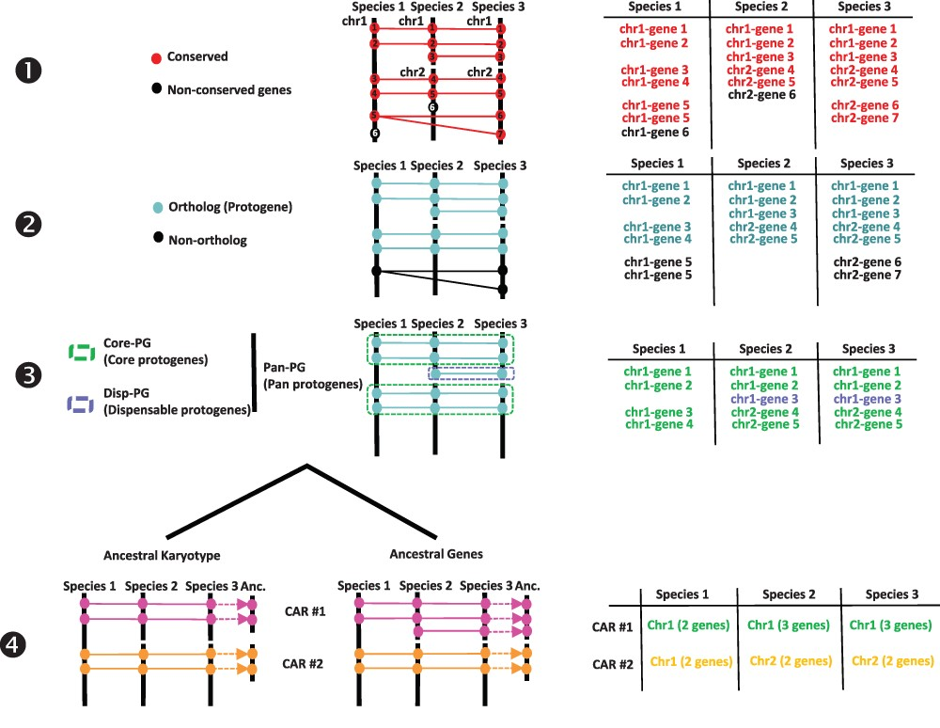
Figure 1. Procedure for reconstructing ancestral karyotypes. Ancestral genomes are inferred from (see the Materials and ...
Notes:
Figure 1. Procedure for reconstructing ancestral karyotypes. Ancestral genomes are inferred from (see the Materials and methods section) conserved genes (Step 1), orthologous relationships (Step 2), SBs (Step 3) and CARs (Step 4), to provide the best scenario explaining the transition between ancestral and modern genomes. Types of tabular files derived from each step are illustrated at the right to help readers to properly follow the procedure (described in and adapted from (20)).
Unless provided in the caption above, the following copyright applies to the content of this slide: © The Author(s) 2023. Published by Oxford University Press.This is an Open Access article distributed under the terms of the Creative Commons Attribution License (https://creativecommons.org/licenses/by/4.0/), which permits unrestricted reuse, distribution, and reproduction in any medium, provided the original work is properly cited.

Slide 3
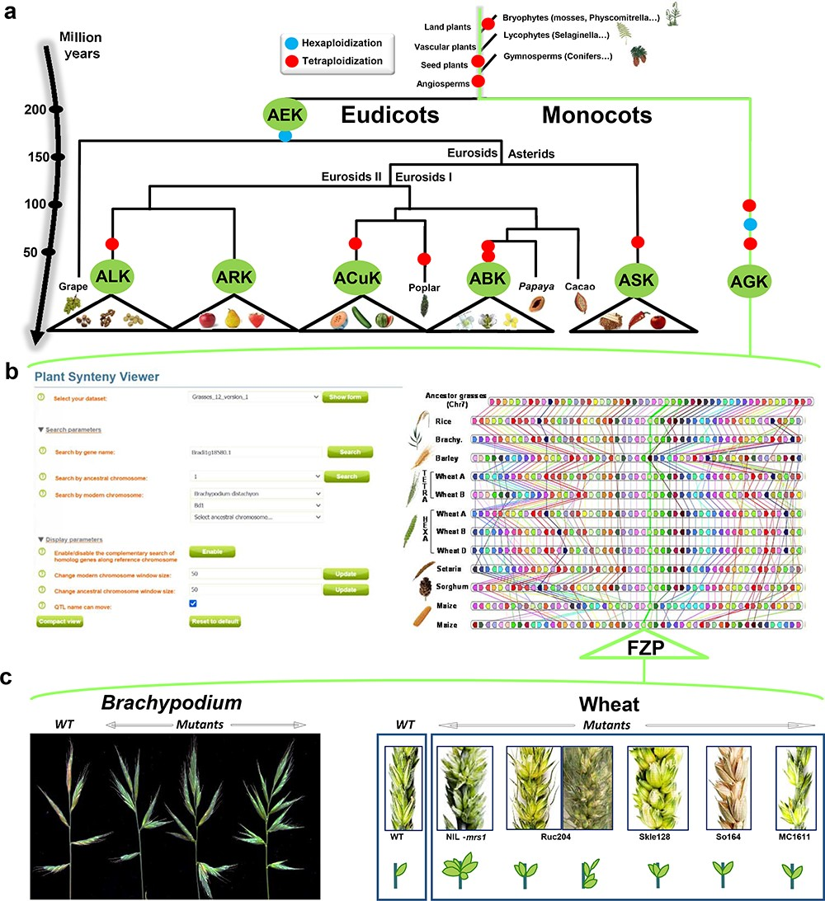
Figure 3. SyntenyViewer, a comparative genomics-driven translational research tool. (a) ‘Plant genome evolution from ...
Notes:
Figure 3. SyntenyViewer, a comparative genomics-driven translational research tool. (a) ‘Plant genome evolution from reconstructed ancestors’. The present-day angiosperm species (bottom) are represented along the evolutionary tree of the Angiosperms from founder ancestors (AGK, AEK, AcuK, ASK, ARK, ABK and ALK) of major botanical families with the time scale shown on the left (in million years). The polyploidization events that have shaped the structure of modern plant genomes during their evolution from inferred ancestors are indicated by red dots (duplication) and blue dots (triplication). (b) ‘SyntenyViewer screen capture’. SyntenyViewer tool with the setting parameters (search by gene name and ancestral or modern chromosomes) illustrated at the left and the derived comparative genomics data visualization, as detailed in the text, at the right (here for cereals). Genes are illustrated as colored boxes for each species (in lines), so that conserved genes are linked with colored lines between species. (c) ‘Synteny-based translational research of FZP gene in grasses’. FZP gene characterization in grasses with orthologs from SyntenyViewer (Panel b) and functional validation in wheat and Brachypodium (in mutants compared to wild type) in deriving similar SS phenotypes (adapted from (47)).
Unless provided in the caption above, the following copyright applies to the content of this slide: © The Author(s) 2023. Published by Oxford University Press.This is an Open Access article distributed under the terms of the Creative Commons Attribution License (https://creativecommons.org/licenses/by/4.0/), which permits unrestricted reuse, distribution, and reproduction in any medium, provided the original work is properly cited.

