Slide 1
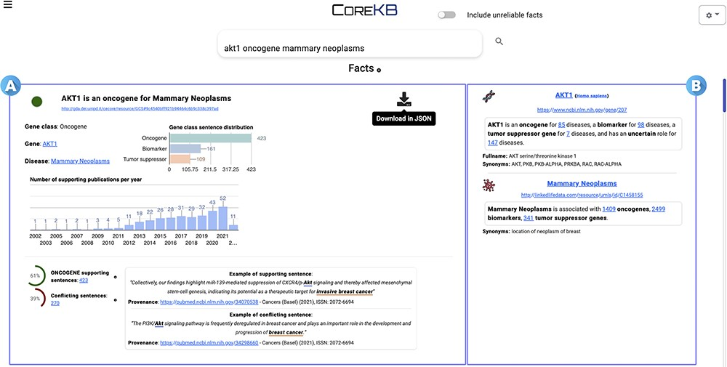
Figure 6. COREKB Search Engine Result Page first result for the query ‘AKT1 oncogene mammary neoplasms’. The retrieved ...
Notes:
Figure 6. COREKB Search Engine Result Page first result for the query ‘AKT1 oncogene mammary neoplasms’. The retrieved facts are organized as cards providing several information concerning (A) the gene, cancer and their relationship and (B) specific information concerning the entities—i.e. gene and the related cancer expression—involved in the association. In addition, card (A) includes infometrics and bibliometrics information to provide further insights. The contents of the cards are available for download in JSON format through the dedicated download button.
Unless provided in the caption above, the following copyright applies to the content of this slide: © The Author(s) 2023. Published by Oxford University Press.This is an Open Access article distributed under the terms of the Creative Commons Attribution License (https://creativecommons.org/licenses/by/4.0/), which permits unrestricted reuse, distribution, and reproduction in any medium, provided the original work is properly cited.

