Slide 1
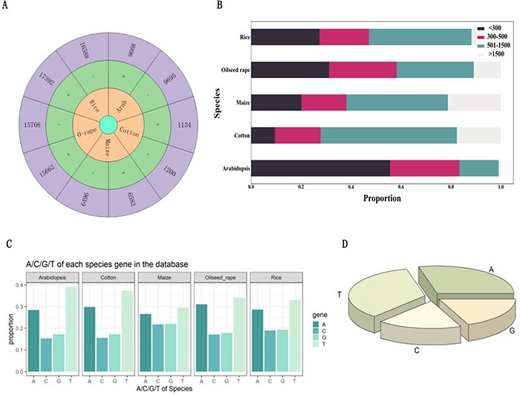
Figure 2. Analysis of introns that hosting functional elements. (A) Number of introns carrying functional elements on ...
Notes:
Figure 2. Analysis of introns that hosting functional elements. (A) Number of introns carrying functional elements on the positive and negative strands of Arabidopsis, cotton, maize, oilseed rape and rice. (B) Length of introns with functional elements in Arabidopsis, cotton, maize, oilseed rape and rice. (C) The proportion of each base in introns with functional elements of Arabidopsis, cotton, maize, oilseed rape and rice. (D) The proportion of bases in all introns with functional elements.
Unless provided in the caption above, the following copyright applies to the content of this slide: © The Author(s) 2023. Published by Oxford University Press.This is an Open Access article distributed under the terms of the Creative Commons Attribution License (https://creativecommons.org/licenses/by/4.0/), which permits unrestricted reuse, distribution, and reproduction in any medium, provided the original work is properly cited.

