Slide 1
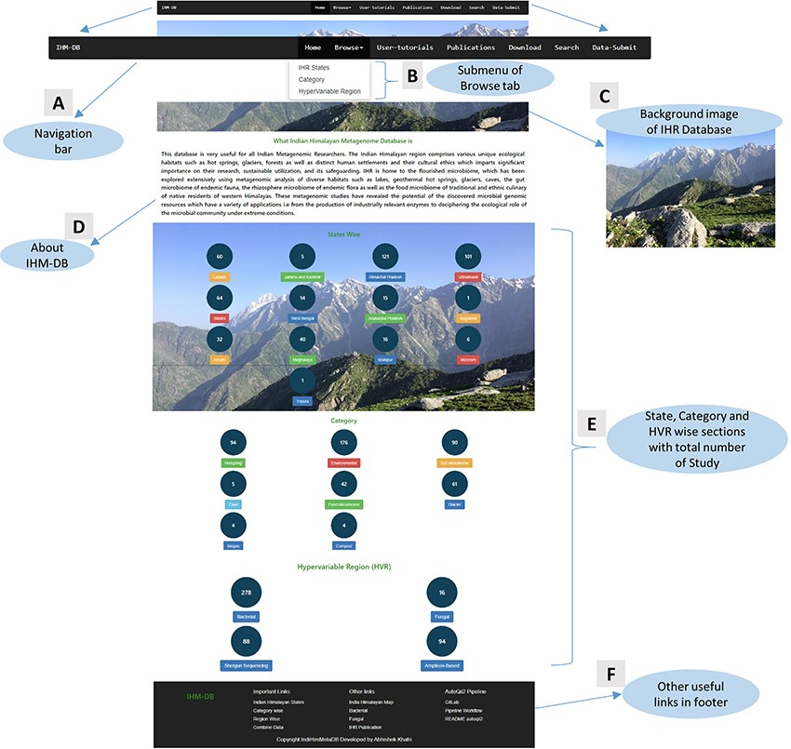
Figure 6. Home page details of the IHM-DB. (A) The home page view of the IHM-DB navigational bar with seven different ...
Notes:
Figure 6. Home page details of the IHM-DB. (A) The home page view of the IHM-DB navigational bar with seven different tabs. (B). Browse tab. It consists of three subtab categories. (C) Background image which describes the Indian Himalayas with a snow line range, including the green Dhauladhar Mountain of Himachal Pradesh. (D) Short description about the IHM-DB. (E) Total number of studies from NCBI, EMBL, and MG-RAST with state-, category- and hypervariable-wise data. (F) Database footer includes other useful links for quick access.
Unless provided in the caption above, the following copyright applies to the content of this slide: © The Author(s) 2023. Published by Oxford University Press.This is an Open Access article distributed under the terms of the Creative Commons Attribution License (https://creativecommons.org/licenses/by/4.0/), which permits unrestricted reuse, distribution, and reproduction in any medium, provided the original work is properly cited.

