Slide 1
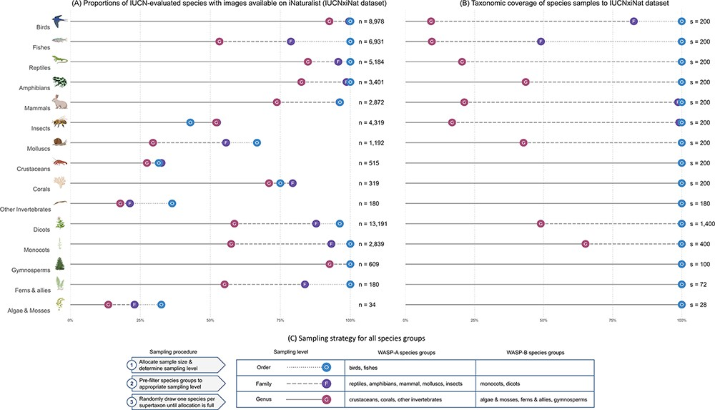
Figure 4. (A) Summary statistics of the IUCNxiNat species dataset presenting the proportions of species evaluated under ...
Notes:
Figure 4. (A) Summary statistics of the IUCNxiNat species dataset presenting the proportions of species evaluated under the IUCN Red List with images available on iNaturalist (left). (B) Taxonomic coverage of the species sample resulting from our sampling strategy to the IUCNxiNat dataset (right). (C) Sampling strategy chosen for all species groups in WASP-A and WASP-B surveys (bottom). The y-axis represents the species groups, each marked with an illustrative icon. The x-axis represents a measure of proportion, or coverage, in percentage. Values are expressed in terms of various taxonomic ranks, including genus (denoted as G with solid line), family (denoted as F with dashed line) and order (denoted as O with dotted line) levels.
Unless provided in the caption above, the following copyright applies to the content of this slide: © The Author(s) 2023. Published by Oxford University Press.This is an Open Access article distributed under the terms of the Creative Commons Attribution License (https://creativecommons.org/licenses/by/4.0/), which permits unrestricted reuse, distribution, and reproduction in any medium, provided the original work is properly cited.

