Slide 1
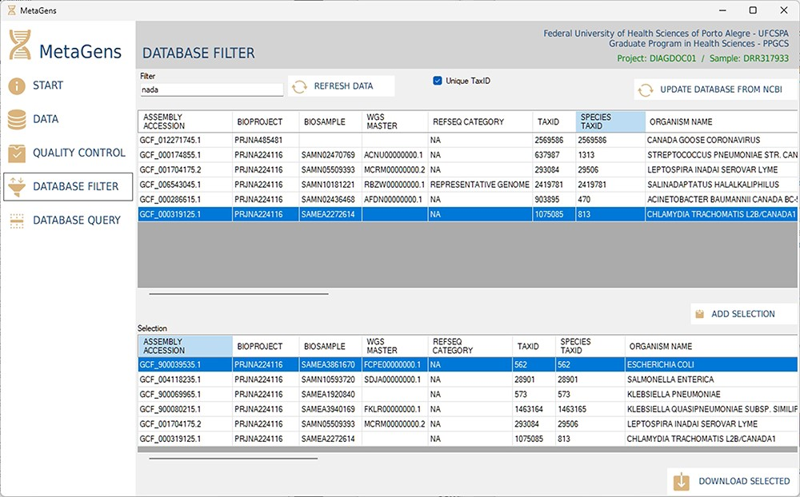
Figure 13. Graphical interface of the MetaGens software showing the database filter panel. When filtering the reference ...
Notes:
Figure 13. Graphical interface of the MetaGens software showing the database filter panel. When filtering the reference sequences, it is possible to reduce the size of the database in order to reduce the analysis time. Source: the authors.
Unless provided in the caption above, the following copyright applies to the content of this slide: © The Author(s) 2023. Published by Oxford University Press.This is an Open Access article distributed under the terms of the Creative Commons Attribution License (https://creativecommons.org/licenses/by/4.0/), which permits unrestricted reuse, distribution, and reproduction in any medium, provided the original work is properly cited.

