Slide 1
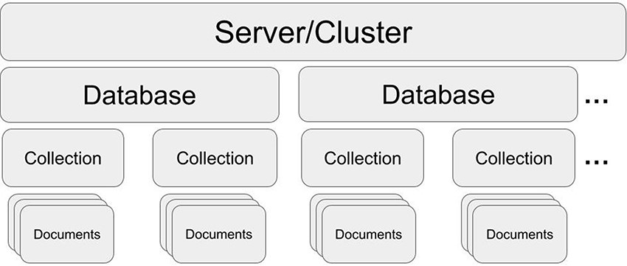
Figure 1. MongoDB structure. One server/cluster can store several databases. Each database can contain collections that ...
Notes:
Figure 1. MongoDB structure. One server/cluster can store several databases. Each database can contain collections that store multiple and separate records as documents (in JSON style).
Unless provided in the caption above, the following copyright applies to the content of this slide: © The Author(s) 2023. Published by Oxford University Press.This is an Open Access article distributed under the terms of the Creative Commons Attribution License (https://creativecommons.org/licenses/by/4.0/), which permits unrestricted reuse, distribution, and reproduction in any medium, provided the original work is properly cited.

Slide 2
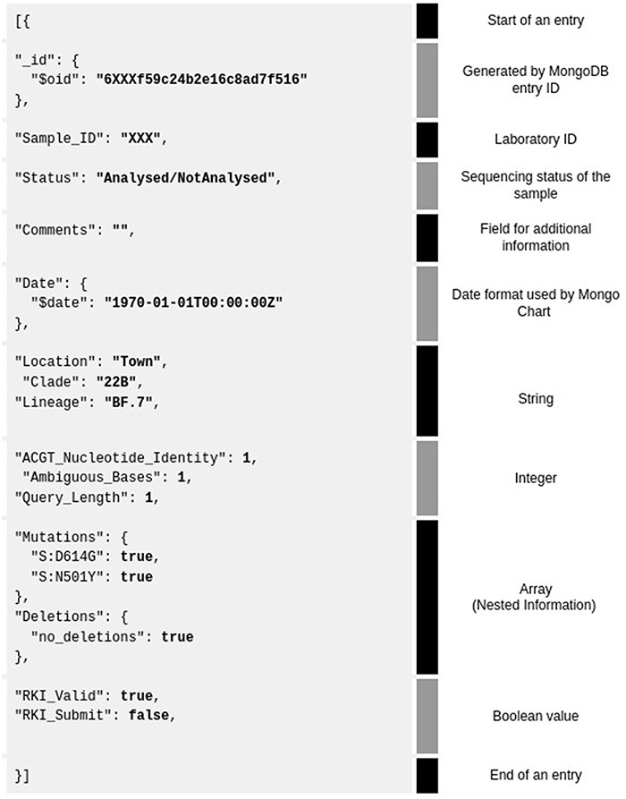
Figure 2. Example of a MongoDB JSON database entry for one sample (grey background). Shown are all the 3–4 data types ...
Notes:
Figure 2. Example of a MongoDB JSON database entry for one sample (grey background). Shown are all the 3–4 data types and their corresponding explanation on the right. The database entry is separated by category (text in black, called ‘key’) and value of data (bold—‘value’) for visualization purposes.
Unless provided in the caption above, the following copyright applies to the content of this slide: © The Author(s) 2023. Published by Oxford University Press.This is an Open Access article distributed under the terms of the Creative Commons Attribution License (https://creativecommons.org/licenses/by/4.0/), which permits unrestricted reuse, distribution, and reproduction in any medium, provided the original work is properly cited.

Slide 3
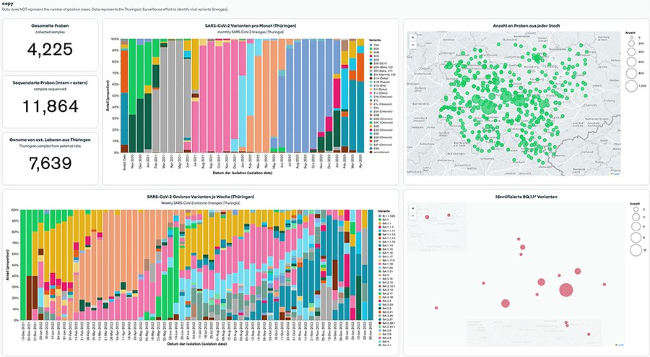
Figure 3. MongoDB Charts dashboard example based on the Thuringian Surveillance Effort for SARS-CoV-2 genomic ...
Notes:
Figure 3. MongoDB Charts dashboard example based on the Thuringian Surveillance Effort for SARS-CoV-2 genomic sequencing. MongoDB Charts are accessible at https://www.bit.ly/3MtK2v2.
Unless provided in the caption above, the following copyright applies to the content of this slide: © The Author(s) 2023. Published by Oxford University Press.This is an Open Access article distributed under the terms of the Creative Commons Attribution License (https://creativecommons.org/licenses/by/4.0/), which permits unrestricted reuse, distribution, and reproduction in any medium, provided the original work is properly cited.

Slide 4
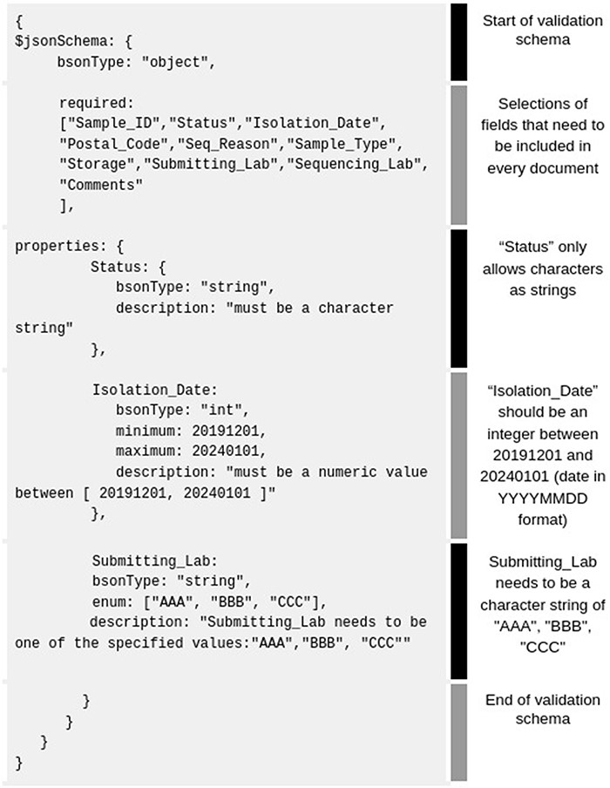
Figure 4. Example of basic MongoDB schema rules (gray background) accepted by the MongoDB Compass validation tab. For ...
Notes:
Figure 4. Example of basic MongoDB schema rules (gray background) accepted by the MongoDB Compass validation tab. For better clarity, we added our own fields like ‘Status’, ‘Isolation _ Date’, ‘Submitting_ Lab’, etc.
Unless provided in the caption above, the following copyright applies to the content of this slide: © The Author(s) 2023. Published by Oxford University Press.This is an Open Access article distributed under the terms of the Creative Commons Attribution License (https://creativecommons.org/licenses/by/4.0/), which permits unrestricted reuse, distribution, and reproduction in any medium, provided the original work is properly cited.

