Slide 1
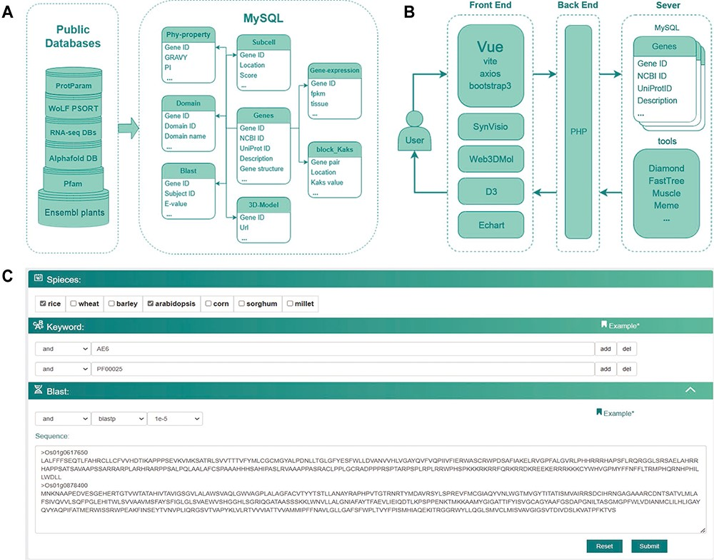
Figure 1. The database construction and MySQL table structure utilized in this study. (A) Public databases or analysis ...
Notes:
Figure 1. The database construction and MySQL table structure utilized in this study. (A) Public databases or analysis websites providing the data which stored in MySQL. Each cylinder in the left frame represents a different public database or analysis website, with the text on the cylinders denoting their respective names or abbreviations. Ensembl plants and Pfam are located at the bottom, with RNA-seq DBs and AlphaFold DB in the middle layer. RNA-seq DBs comprise GEO, Plant Public RNA-seq Database and PlantNexus, while AlphaFold DB represents the AlphaFold Protein Structure Database. Proparam and WoLF PSORT are positioned at the top. The right frame depicts the design of the MySQL tables, specifically Phy-property, Subcell, Gene-expression, Domain, Blast, 3D-Model, Block_Kaks and Genes. The arrows represent different tables linked through the Gene ID field. (B) The database construction relied on plug-in components, tools and frames. (C) Search module utilized together with options (AND, OR), combining keywords and blast in a certain way in accordance with specific research requirements.
Unless provided in the caption above, the following copyright applies to the content of this slide: © The Author(s) 2023. Published by Oxford University Press.This is an Open Access article distributed under the terms of the Creative Commons Attribution License (https://creativecommons.org/licenses/by/4.0/), which permits unrestricted reuse, distribution, and reproduction in any medium, provided the original work is properly cited.

Slide 2
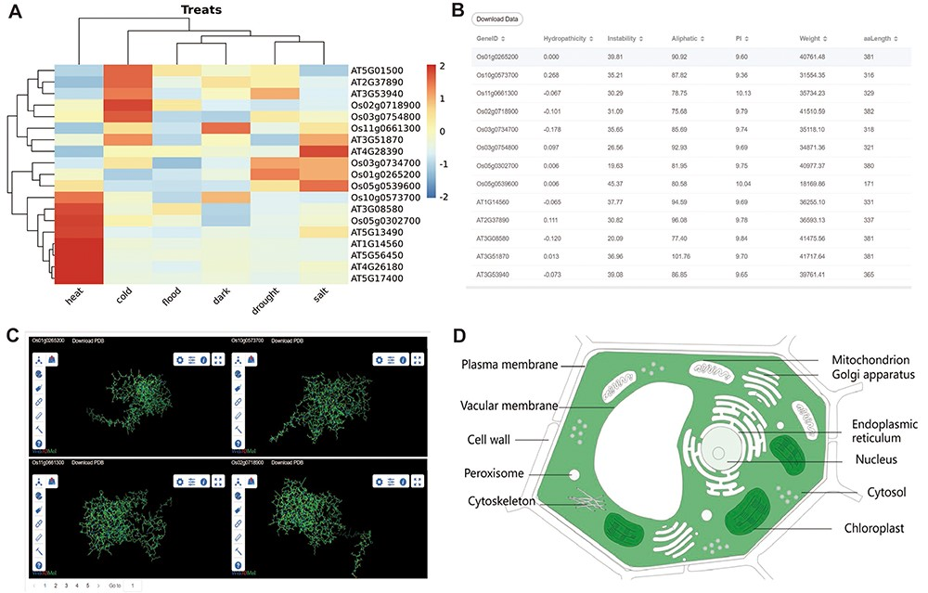
Figure 3. The other part of downstream analysis modules about transcriptome and proteome. (A) Expression module, gene ...
Notes:
Figure 3. The other part of downstream analysis modules about transcriptome and proteome. (A) Expression module, gene expression in heat, cold, flood, dark, drought and salt conditions visualized by heatmap. (B) Physicochemical properties modules with PI, hydropathicity, Aliphatic, Instability, Weight and amino acids length. (C) 3D-Model module presenting four 3D structures at once. The ID and download are at the top of each structure. (D) Subcell modules with dark part meaning more genes localized there.
Unless provided in the caption above, the following copyright applies to the content of this slide: © The Author(s) 2023. Published by Oxford University Press.This is an Open Access article distributed under the terms of the Creative Commons Attribution License (https://creativecommons.org/licenses/by/4.0/), which permits unrestricted reuse, distribution, and reproduction in any medium, provided the original work is properly cited.

Slide 3
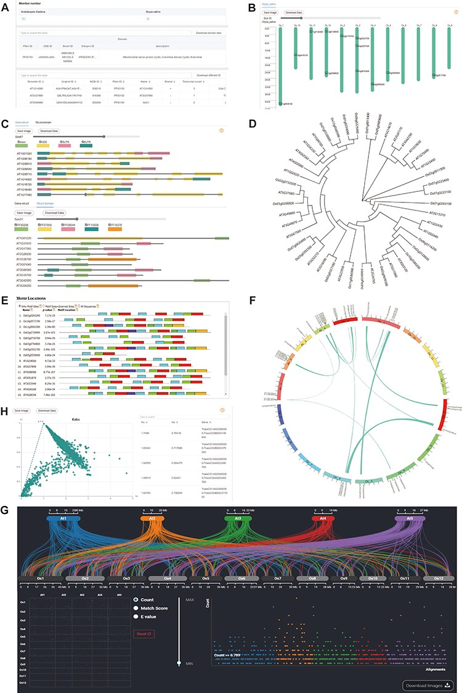
Figure 2. Downstream analysis modules at genome level. (A) Basic-info module. The top part indicates the number of ...
Notes:
Figure 2. Downstream analysis modules at genome level. (A) Basic-info module. The top part indicates the number of family members in each species. The middle section gives information about the domains (if any) in the gene family. The bottom part lists the specific information about the family members. (B) Chromosome Location module with members on each chromosome. (C) Gene-Structure module with visualized structures on gene and domains on protein. (D) Tree module with phylogenetic tree. (E) Motif module with motif locations. (F) Collinerity module with visualized collinerity gene on circle diagram. (G) Sythi module with parallel link plot and dot plot of collinerity gene plot. (H) KaKs module, scatterplot on the left and search table on the right.
Unless provided in the caption above, the following copyright applies to the content of this slide: © The Author(s) 2023. Published by Oxford University Press.This is an Open Access article distributed under the terms of the Creative Commons Attribution License (https://creativecommons.org/licenses/by/4.0/), which permits unrestricted reuse, distribution, and reproduction in any medium, provided the original work is properly cited.

