Slide 1
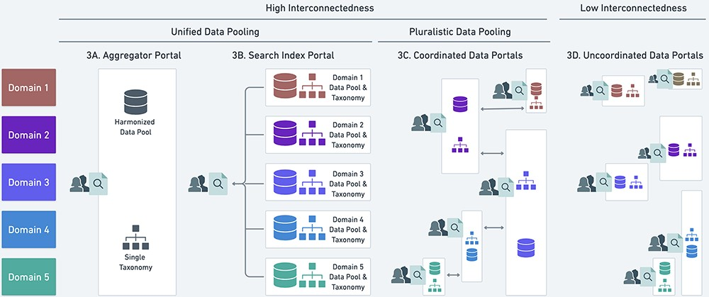
Figure 3. Four possible heuristics (A–D) for data pooling and their relationship to the unified and pluralistic ideals. ...
Notes:
Figure 3. Four possible heuristics (A–D) for data pooling and their relationship to the unified and pluralistic ideals. See main text for discussion of A-D. White boxes represent distinct data portals, and colored symbols within the box represent data standardized to a local, potentially unique taxonomic classification that is not deliberately harmonized with other taxonomies. The vertical overlap in white boxes indicates where portals overlap in the scope of data they include.
Unless provided in the caption above, the following copyright applies to the content of this slide: © The Author(s) 2023. Published by Oxford University Press.This is an Open Access article distributed under the terms of the Creative Commons Attribution License (https://creativecommons.org/licenses/by/4.0/), which permits unrestricted reuse, distribution, and reproduction in any medium, provided the original work is properly cited.

