Slide 1
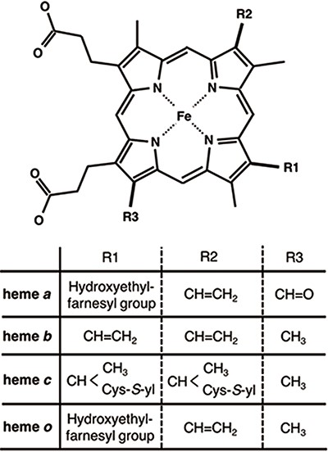
Figure 1. Chemical structures of hemes. R1, R2 and R3 in the upper structure correspond to those in the lower table. ...
Notes:
Figure 1. Chemical structures of hemes. R1, R2 and R3 in the upper structure correspond to those in the lower table. Heme c forms covalent bonds between the ethenyl groups in heme and the thiol groups of Cys residues in its host protein.
Unless provided in the caption above, the following copyright applies to the content of this slide: © The Author(s) 2020. Published by Oxford University Press.This is an Open Access article distributed under the terms of the Creative Commons Attribution License (http://creativecommons.org/licenses/by/4.0/), which permits unrestricted reuse, distribution, and reproduction in any medium, provided the original work is properly cited.

