Slide 1
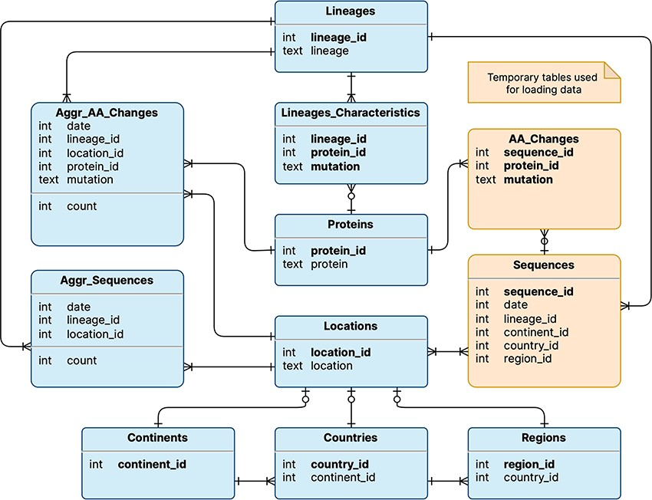
Figure 1. Logical schema of the database used by VariantHunter. Orange tables are created during the parsing of the ...
Notes:
Figure 1. Logical schema of the database used by VariantHunter. Orange tables are created during the parsing of the input file from genomic data sources and then deleted when the blue tables have been constructed, as information about individual sequences is not needed by the tool.
Unless provided in the caption above, the following copyright applies to the content of this slide: © The Author(s) 2023. Published by Oxford University Press.This is an Open Access article distributed under the terms of the Creative Commons Attribution License (https://creativecommons.org/licenses/by/4.0/), which permits unrestricted reuse, distribution, and reproduction in any medium, provided the original work is properly cited.

Slide 2
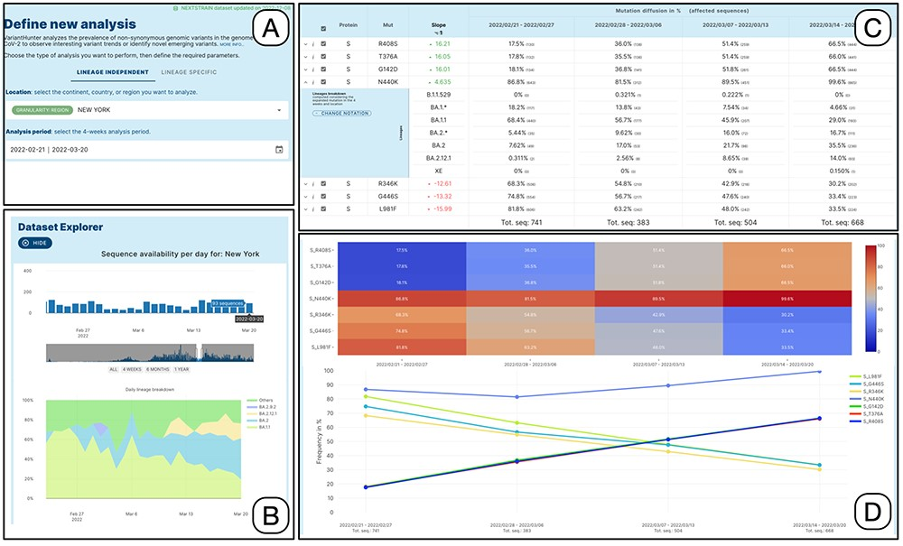
Figure 2. Lineage-independent analysis of sequences collected in the New York state between February 21 and 20 March ...
Notes:
Figure 2. Lineage-independent analysis of sequences collected in the New York state between February 21 and 20 March 2022—corresponding to the transition from Omicron 1 (BA.1) to Omicron 2 (BA.2). Panel A: setting of the analysis parameters; Panel B: overview of the prevalence SARS-CoV-2 lineages; Panel C: amino acid changes with the highest change in prevalence (for the amino acid change N440K on the Spike protein, the lineage breakdown is shown); Panel D: diffusion heatmap and line plot of the prevalence of the changes selected in the table. Three of them have a similar highly increasing trend, N440K is increasing at a slower rate starting from a higher prevalence, whereas the last three are decreasing at various similar rates.
Unless provided in the caption above, the following copyright applies to the content of this slide: © The Author(s) 2023. Published by Oxford University Press.This is an Open Access article distributed under the terms of the Creative Commons Attribution License (https://creativecommons.org/licenses/by/4.0/), which permits unrestricted reuse, distribution, and reproduction in any medium, provided the original work is properly cited.

Slide 3
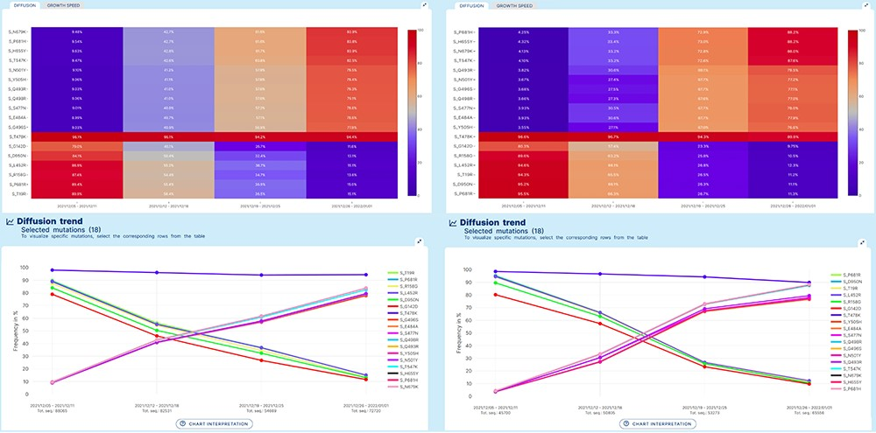
Figure 3. Lineage-independent analysis use case. Spread of the Omicron variant and displacement of Delta in Europe and ...
Notes:
Figure 3. Lineage-independent analysis use case. Spread of the Omicron variant and displacement of Delta in Europe and North America. Note that, for Omicron, only a selection of 11 defining amino acid changes is shown for space constraints.
Unless provided in the caption above, the following copyright applies to the content of this slide: © The Author(s) 2023. Published by Oxford University Press.This is an Open Access article distributed under the terms of the Creative Commons Attribution License (https://creativecommons.org/licenses/by/4.0/), which permits unrestricted reuse, distribution, and reproduction in any medium, provided the original work is properly cited.

Slide 4
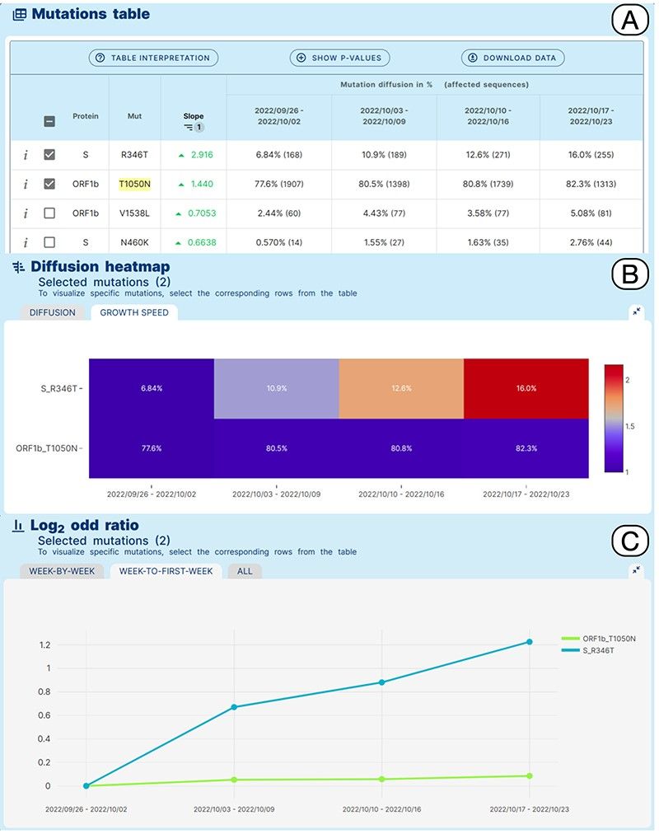
Figure 4. Lineage-specific analysis use case. Emergence of sub-lineage BA.5.2.39 in North America.
Notes:
Figure 4. Lineage-specific analysis use case. Emergence of sub-lineage BA.5.2.39 in North America.
Unless provided in the caption above, the following copyright applies to the content of this slide: © The Author(s) 2023. Published by Oxford University Press.This is an Open Access article distributed under the terms of the Creative Commons Attribution License (https://creativecommons.org/licenses/by/4.0/), which permits unrestricted reuse, distribution, and reproduction in any medium, provided the original work is properly cited.

