Slide 1
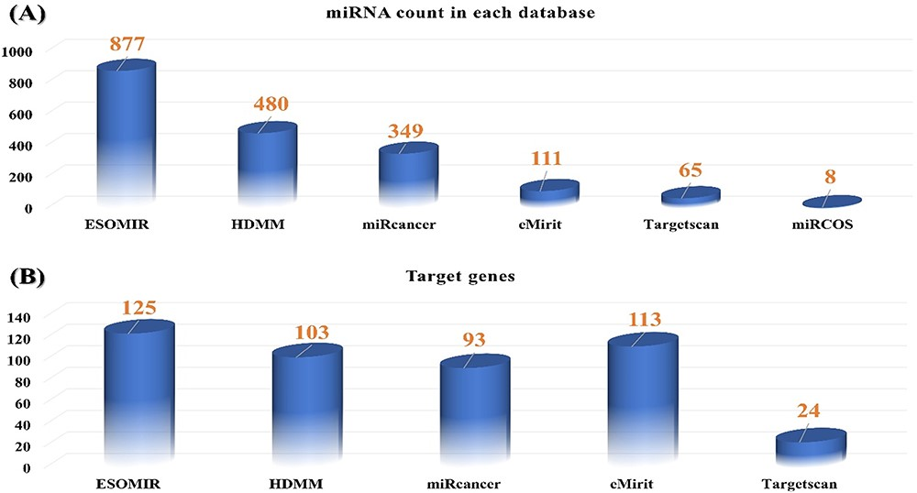
Figure 2. (A) Comparison of all available miRNA targets associated with EC in ESOMIR and other available databases. The ...
Notes:
Figure 2. (A) Comparison of all available miRNA targets associated with EC in ESOMIR and other available databases. The figure shows that ESOMIR has the highest number of miRNAs included in contrast to the other available databases. (B) Comparison of all available mRNAs associated with EC in ESOMIR and other available databases.
Unless provided in the caption above, the following copyright applies to the content of this slide: © The Author(s) 2023. Published by Oxford University Press.This is an Open Access article distributed under the terms of the Creative Commons Attribution License (https://creativecommons.org/licenses/by/4.0/), which permits unrestricted reuse, distribution, and reproduction in any medium, provided the original work is properly cited.

