Slide 1
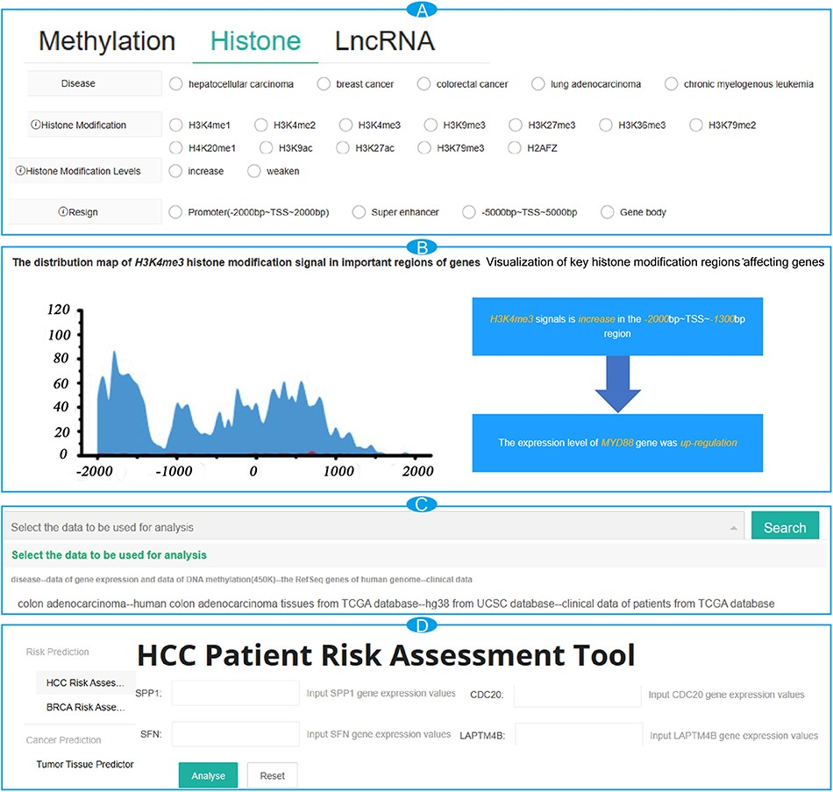
Figure 1. The interface of the browse module for CancerMHL. (A) The interface of the search modules; (B) search result ...
Notes:
Figure 1. The interface of the browse module for CancerMHL. (A) The interface of the search modules; (B) search result page for MYD88 with detailed information; (C) module interface for analyzing results based on DNA methylation and histone modification data; (D) the interface of the tool modules.
Unless provided in the caption above, the following copyright applies to the content of this slide: © The Author(s) 2024. Published by Oxford University Press.This is an Open Access article distributed under the terms of the Creative Commons Attribution License (https://creativecommons.org/licenses/by/4.0/), which permits unrestricted reuse, distribution, and reproduction in any medium, provided the original work is properly cited.

