Slide 1
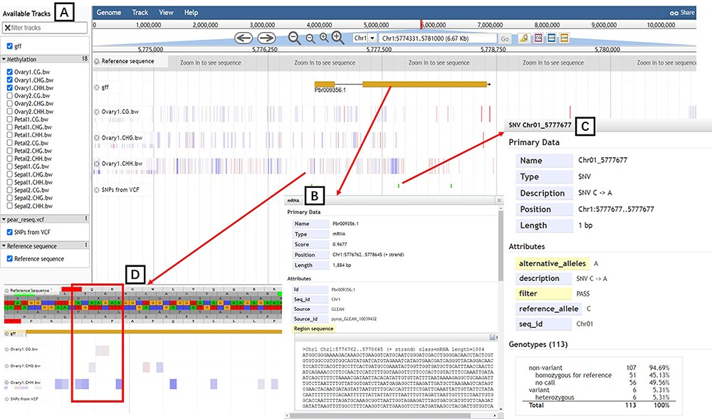
Figure 5. JBrowse tool. (A) Available tracks for different types of genomic features. (B) A window showing detailed ...
Notes:
Figure 5. JBrowse tool. (A) Available tracks for different types of genomic features. (B) A window showing detailed information of the target gene model. (C) SNPs information for 113 pear accessions. (D) Tracks of three types of DNA methylation.
Unless provided in the caption above, the following copyright applies to the content of this slide: © The Author(s) 2023. Published by Oxford University Press.This is an Open Access article distributed under the terms of the Creative Commons Attribution License (https://creativecommons.org/licenses/by/4.0/), which permits unrestricted reuse, distribution, and reproduction in any medium, provided the original work is properly cited.

