Slide 1
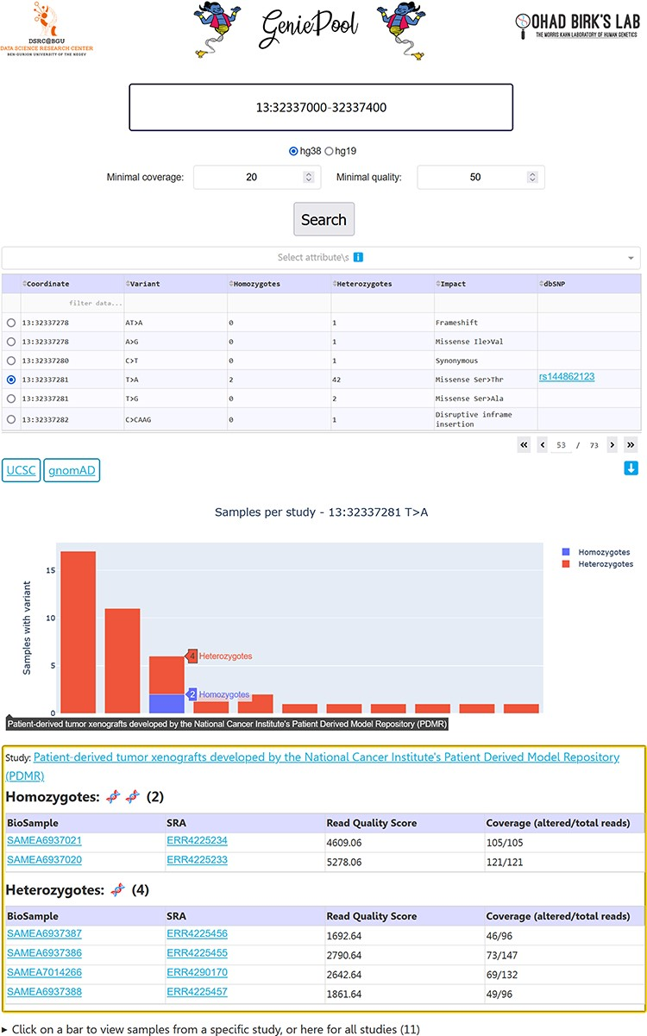
Figure 2. GeniePool’s UI. Genomic coordinates can be searched for variants within NGS samples from SRA. Results are ...
Notes:
Figure 2. GeniePool’s UI. Genomic coordinates can be searched for variants within NGS samples from SRA. Results are displayed in a table with selectable rows. Variants can be filtered by sample attributes. Selecting a variant generates an interactive graph displaying relevant samples per study. Clicking a bar provides direct links for additional information regarding the study and each of the samples harbouring the variant.
Unless provided in the caption above, the following copyright applies to the content of this slide: © The Author(s) 2023. Published by Oxford University Press.This is an Open Access article distributed under the terms of the Creative Commons Attribution License (https://creativecommons.org/licenses/by/4.0/), which permits unrestricted reuse, distribution, and reproduction in any medium, provided the original work is properly cited.

Slide 2
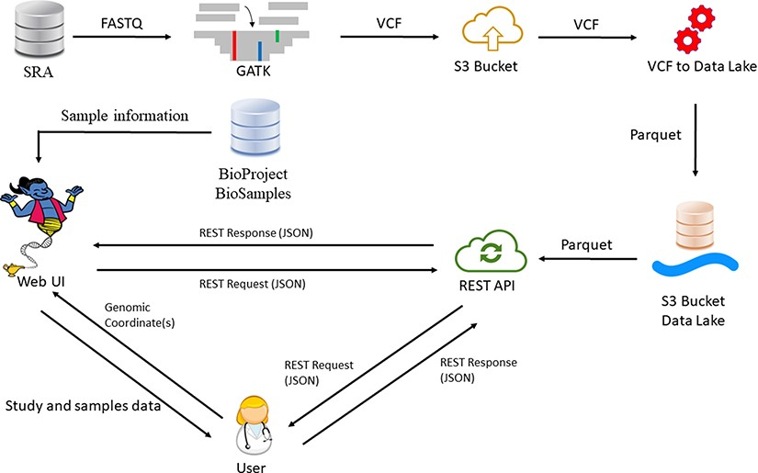
Figure 1. GeniePool workflow. Raw genomic NGS data from SRA are preprocessed according to GATK’s best practices and ...
Notes:
Figure 1. GeniePool workflow. Raw genomic NGS data from SRA are preprocessed according to GATK’s best practices and stored efficiently using the Parquet format in a cloud data lake architecture. Preprocessed data are available via either a REST API or a designated web UI accompanied by BioSample data that provide information regarding specific samples.
Unless provided in the caption above, the following copyright applies to the content of this slide: © The Author(s) 2023. Published by Oxford University Press.This is an Open Access article distributed under the terms of the Creative Commons Attribution License (https://creativecommons.org/licenses/by/4.0/), which permits unrestricted reuse, distribution, and reproduction in any medium, provided the original work is properly cited.

