Slide 1
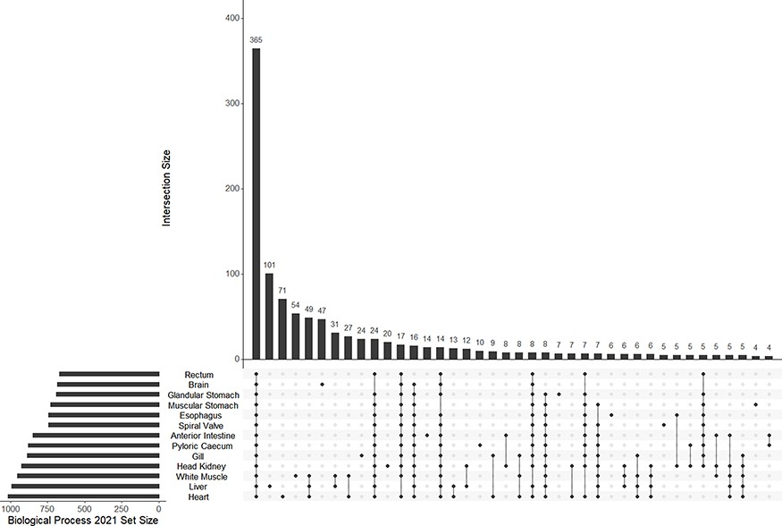
Figure 4. The UpSet plot of shared and unique GO terms from each of 13 tissue-specific transcriptomes of the lake ...
Notes:
Figure 4. The UpSet plot of shared and unique GO terms from each of 13 tissue-specific transcriptomes of the lake sturgeon (Acipenser fulvescens). The GO terms presented here are from the Biological Process 2021 database, significant at q < 0.05. The R package UpSetR was used to visualize these data.
Unless provided in the caption above, the following copyright applies to the content of this slide: © The Author(s) 2023. Published by Oxford University Press.This is an Open Access article distributed under the terms of the Creative Commons Attribution License (https://creativecommons.org/licenses/by/4.0/), which permits unrestricted reuse, distribution, and reproduction in any medium, provided the original work is properly cited.

