Slide 1
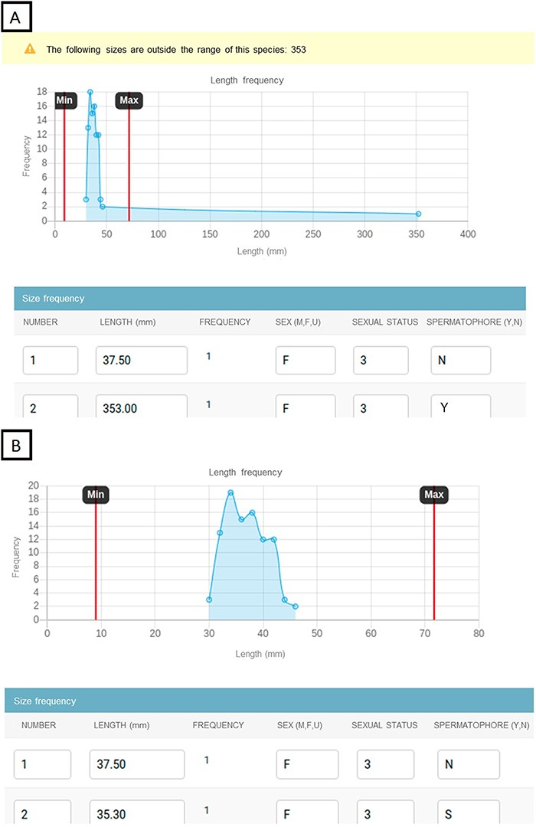
Figure 8. Example of the data input website to prevent incorrect data. The website displays a line chart with the ...
Notes:
Figure 8. Example of the data input website to prevent incorrect data. The website displays a line chart with the length frequency and species’ length ranges. If some lengths are out of the range, they can be detected in the length frequency chart and the website triggers a warning with the lengths that need to be checked. Chart showing the lengths out of range with a warning detecting the outliers (A). Chart showing the fixed lengths that fall within the range values (B).
Unless provided in the caption above, the following copyright applies to the content of this slide: © The Author(s) 2023. Published by Oxford University Press.This is an Open Access article distributed under the terms of the Creative Commons Attribution License (https://creativecommons.org/licenses/by/4.0/), which permits unrestricted reuse, distribution, and reproduction in any medium, provided the original work is properly cited.

