Slide 1
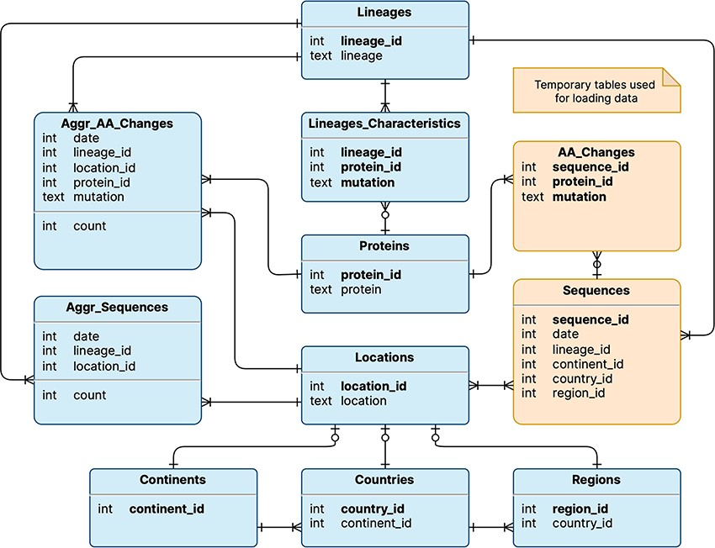
Figure 1. Logical schema of the database used by VariantHunter. Orange tables are created during the parsing of the ...
Notes:
Figure 1. Logical schema of the database used by VariantHunter. Orange tables are created during the parsing of the input file from genomic data sources and then deleted when the blue tables have been constructed, as information about individual sequences is not needed by the tool.
Unless provided in the caption above, the following copyright applies to the content of this slide: © The Author(s) 2023. Published by Oxford University Press.This is an Open Access article distributed under the terms of the Creative Commons Attribution License (https://creativecommons.org/licenses/by/4.0/), which permits unrestricted reuse, distribution, and reproduction in any medium, provided the original work is properly cited.

