Slide 1
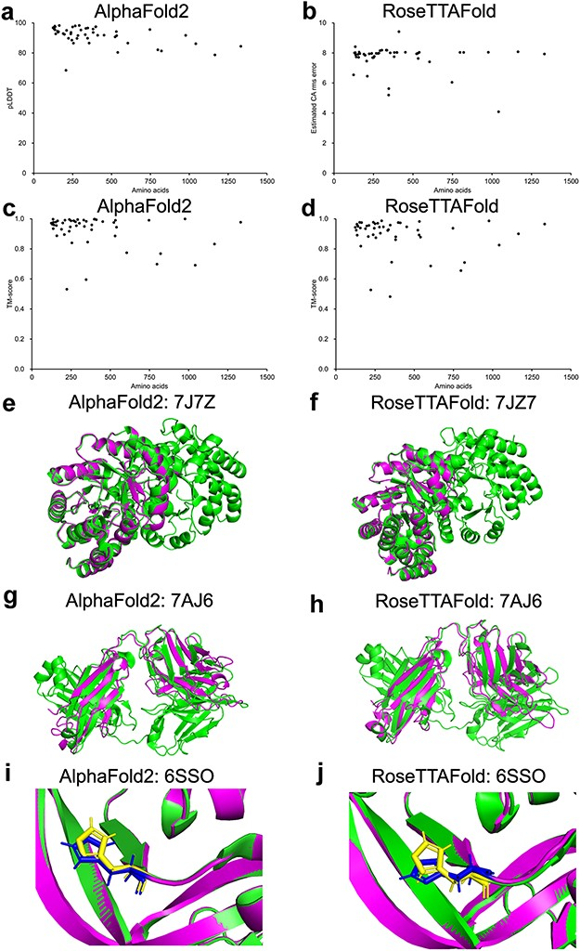
Figure 1. Model confidence profiling for validation genes. (a–d) The corresponding pLDDT (estimated CA rms error) and ...
Notes:
Figure 1. Model confidence profiling for validation genes. (a–d) The corresponding pLDDT (estimated CA rms error) and TM-score of each prediction generated by AlphaFold2 and RoseTTAFold were plotted. (e–h) Structural alignments of prediction of 7JZ7 and 7AJ6. (i–j) Similar geometry of the side chains of 6SSO.
Unless provided in the caption above, the following copyright applies to the content of this slide: © The Author(s) 2023. Published by Oxford University Press.This is an Open Access article distributed under the terms of the Creative Commons Attribution License (https://creativecommons.org/licenses/by/4.0/), which permits unrestricted reuse, distribution, and reproduction in any medium, provided the original work is properly cited.

Slide 2
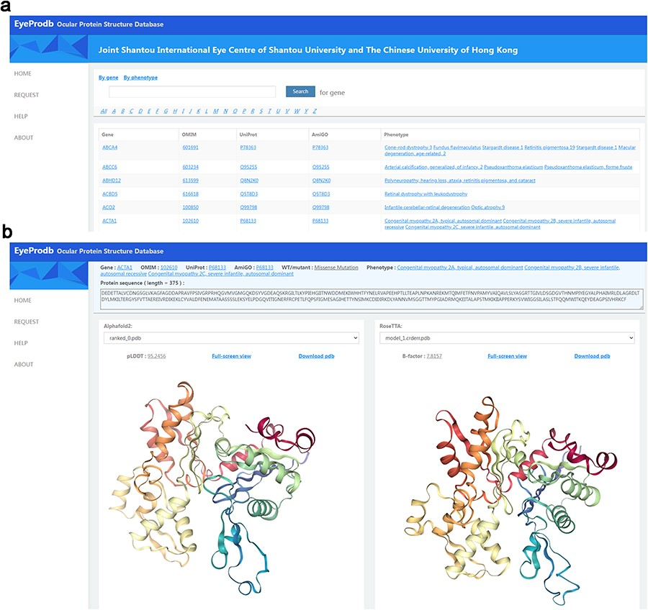
Figure 2. Searching EyeProdb. (a) EyeProdb provides a search engine to find ocular proteins of interest based on ...
Notes:
Figure 2. Searching EyeProdb. (a) EyeProdb provides a search engine to find ocular proteins of interest based on gene/protein name or phenotype. (b) Meta-information and 3D visualization of the EyeProdb structure predictions.
Unless provided in the caption above, the following copyright applies to the content of this slide: © The Author(s) 2023. Published by Oxford University Press.This is an Open Access article distributed under the terms of the Creative Commons Attribution License (https://creativecommons.org/licenses/by/4.0/), which permits unrestricted reuse, distribution, and reproduction in any medium, provided the original work is properly cited.

Slide 3
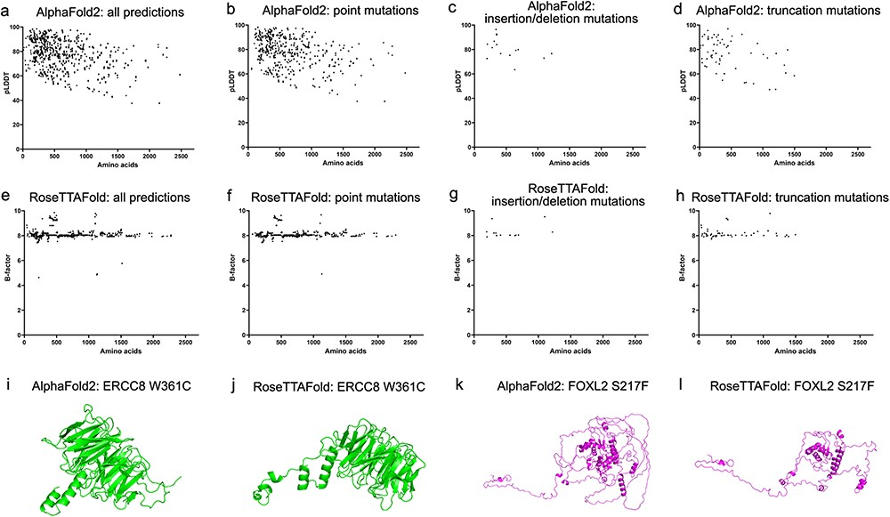
Figure 3. Model confidence profiling for ocular genes. (a and e) The pLDDT by AlphaFold2 and estimated CA rms error by ...
Notes:
Figure 3. Model confidence profiling for ocular genes. (a and e) The pLDDT by AlphaFold2 and estimated CA rms error by RoseTTAFold for each prediction were plotted with the number of residues. (b–d and f–h) The pLDDT and estimated CA rms error were plotted according to different types of mutations.
Unless provided in the caption above, the following copyright applies to the content of this slide: © The Author(s) 2023. Published by Oxford University Press.This is an Open Access article distributed under the terms of the Creative Commons Attribution License (https://creativecommons.org/licenses/by/4.0/), which permits unrestricted reuse, distribution, and reproduction in any medium, provided the original work is properly cited.

Slide 4
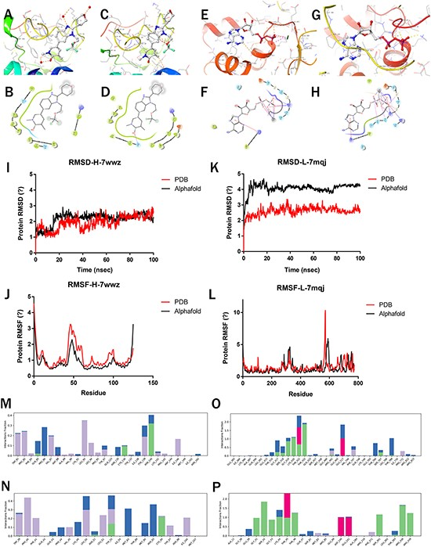
Figure 4. Molecular simulations of Highlighted predictions compared with PDB structures. (a–b) 7wwz-PDB-Protein docking ...
Notes:
Figure 4. Molecular simulations of Highlighted predictions compared with PDB structures. (a–b) 7wwz-PDB-Protein docking with 7ow; (c–d) 7wwz-Alphafold-Protein docking with 7ow; (e–f) 7mqj-PDB-Protein docking with ADP; (g–h) 7mqj-Alphafold-Protein docking with ADP; (i–k) RMSD of 7wwz and 7mqj; (j–l) RMSF of 7wwz and 7mqj; (m–p) Complex interaction: (m) 7wwz-PDB-Complex, (n) 7wwz-Alphafold-Complex, (o) 7mqj-PDB-Complex, (p) 7mqj-Alphafold-Complex.
Unless provided in the caption above, the following copyright applies to the content of this slide: © The Author(s) 2023. Published by Oxford University Press.This is an Open Access article distributed under the terms of the Creative Commons Attribution License (https://creativecommons.org/licenses/by/4.0/), which permits unrestricted reuse, distribution, and reproduction in any medium, provided the original work is properly cited.

