Slide 1
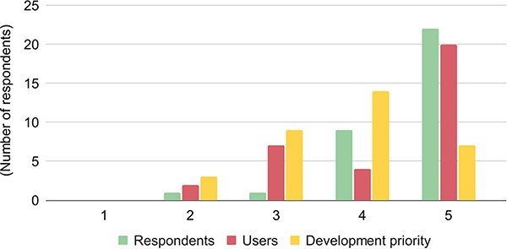
Figure 4. The importance of data discoverability and availability for respondents/databases (green), users (red), and ...
Notes:
Figure 4. The importance of data discoverability and availability for respondents/databases (green), users (red), and development priorities (yellow). The respondents ranked the importance from 1 to 5, with 1 denoting the lowest importance and 5 denoting the highest importance.
Unless provided in the caption above, the following copyright applies to the content of this slide: Published by Oxford University Press 2023. This work is written by (a) US Government employee(s) and is in the public domain in the US.This work is written by (a) US Government employee(s) and is in the public domain in the US.

